Slide 1
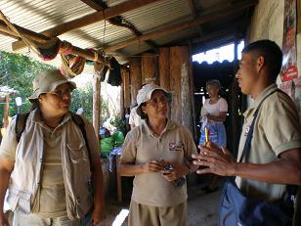
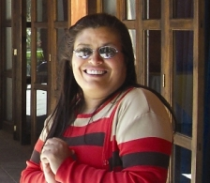

Simple measures prevent the spread of Chagas disease in Latin America
Maria Carlota Monroy
Founder and senior researcher at the laboratory of Applied Entomology and Parasitology at San Carlos University, Guatemala

Slide 2
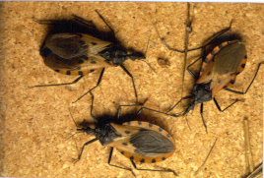
Chagas spread by ‘kissing bugs’ (Triatoma dimidiata) which carry the Trypanosoma cruzi parasite
Estimated 10 million affected in Latin America
Effects (organ failure, death) may be delayed for decades

Slide 3
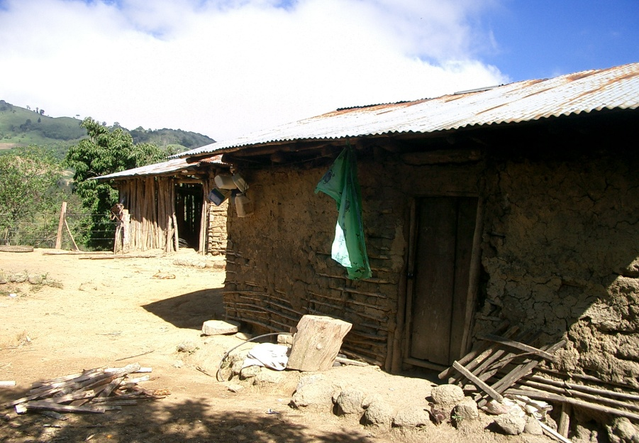
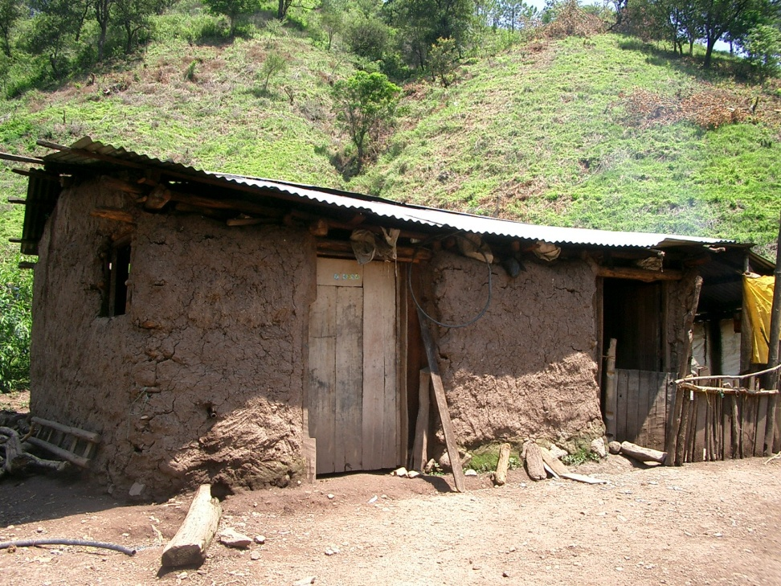
Mud constructed houses with few or no windows (cultural factors) are a place for bugs reproduction in Central America

Slide 4
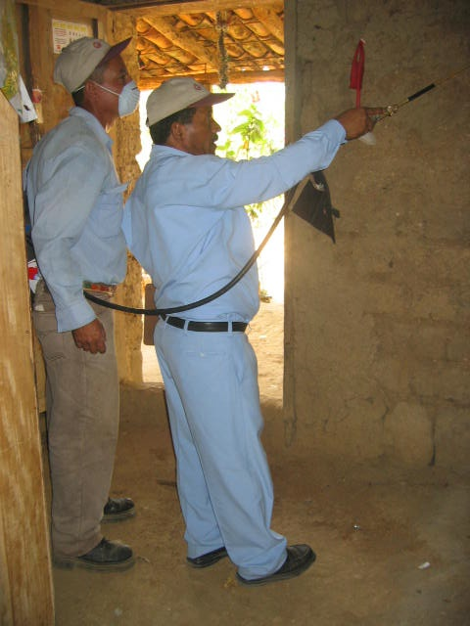
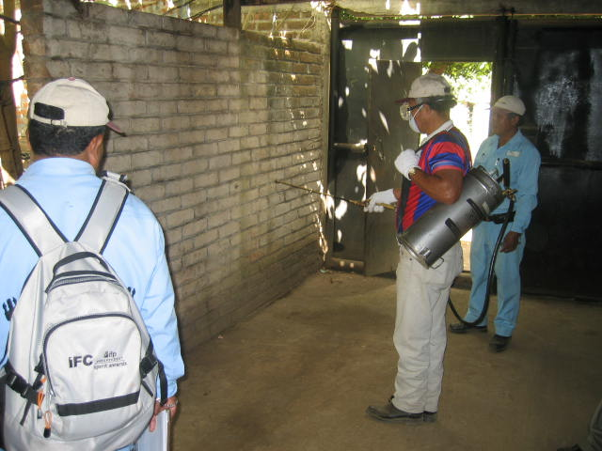
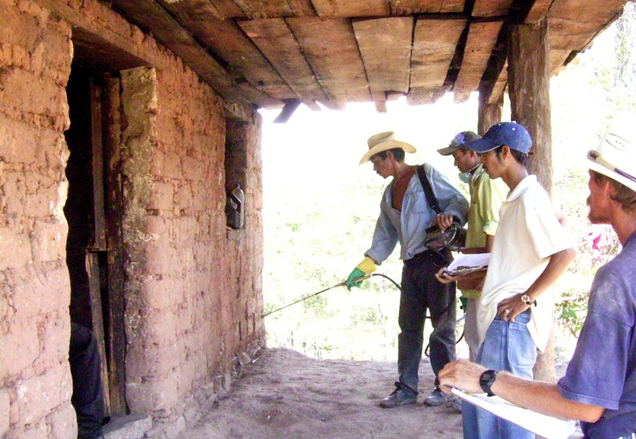
Limited effectiveness of insecticide spraying
Residual effect only lasting 3-5 months, no effect on Triatomine eggs. Mud construction requires more insecticide use.

Slide 5
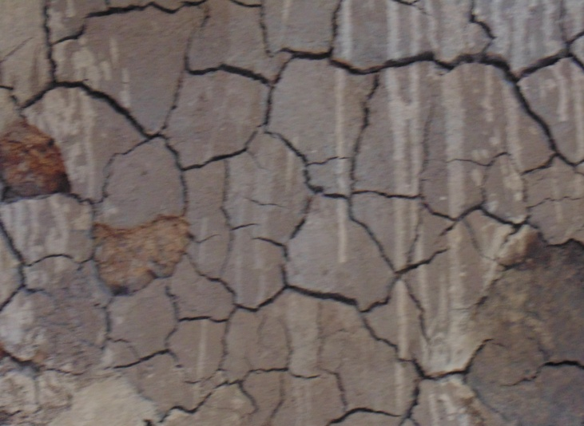
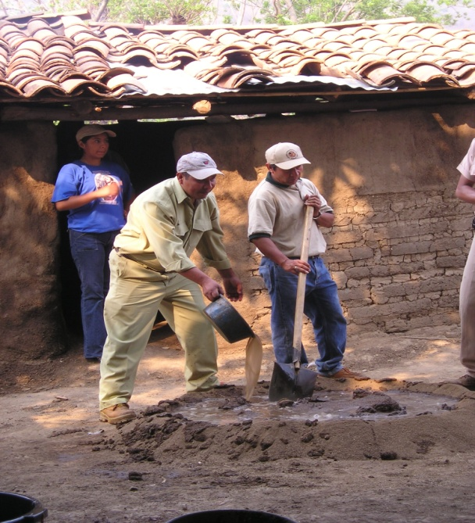
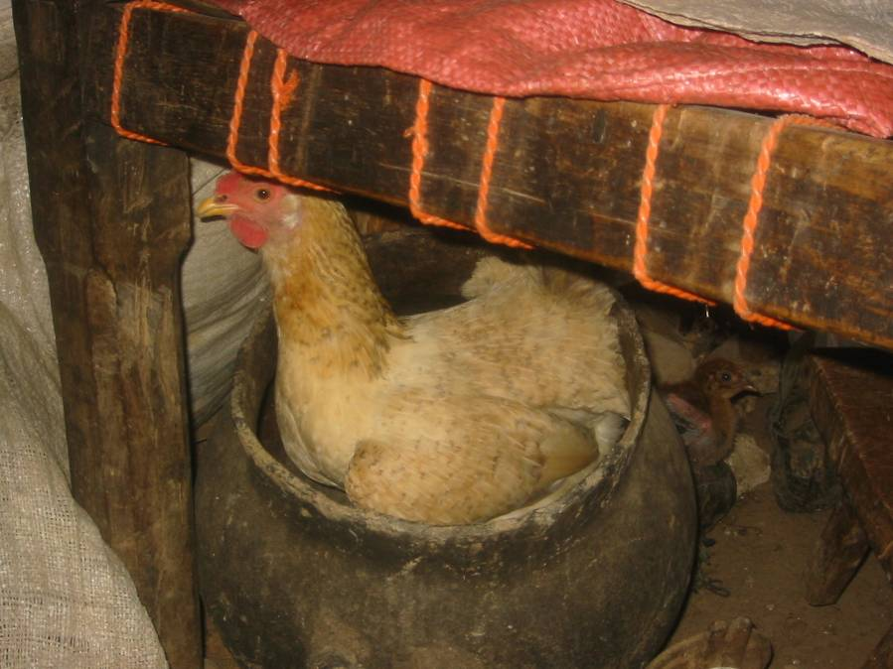
EcoHealth approach
Risk factor determination and design of the EcoHealth-based interventions
Based on protective effect , shared risks with other diseases or other health benefits
Interventions:
  Plastering of walls and floors
  Moving animals outside the house

Slide 6
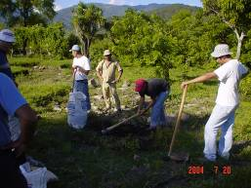
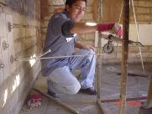
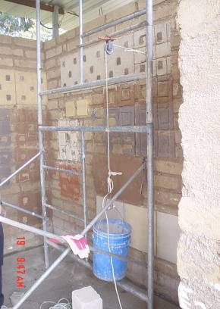
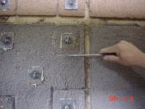
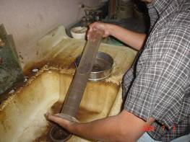
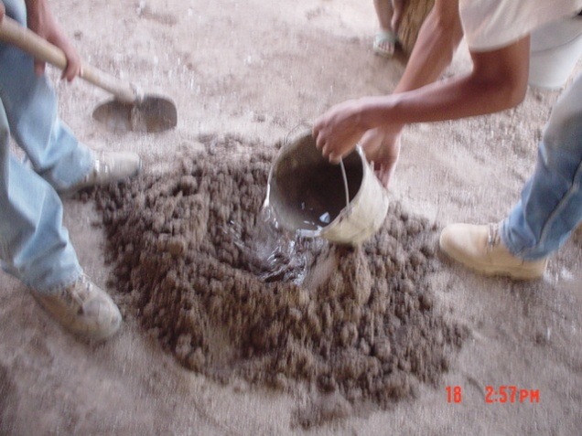
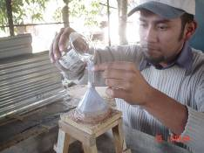
Use of local resources is essential , need laboratory and field tests.
Volcanic ashes, river sand and mud are the local material used for the improvements

Slide 7
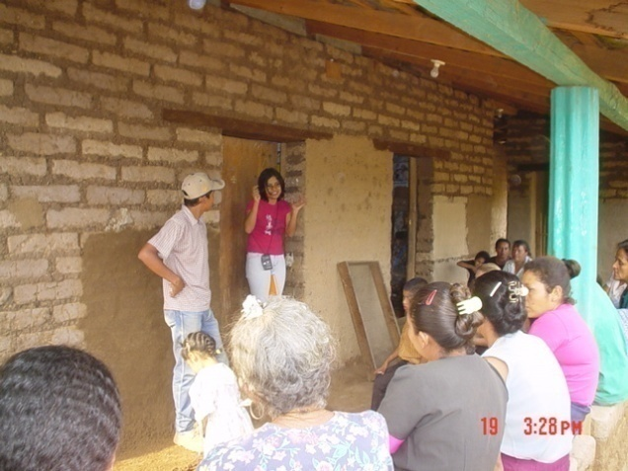
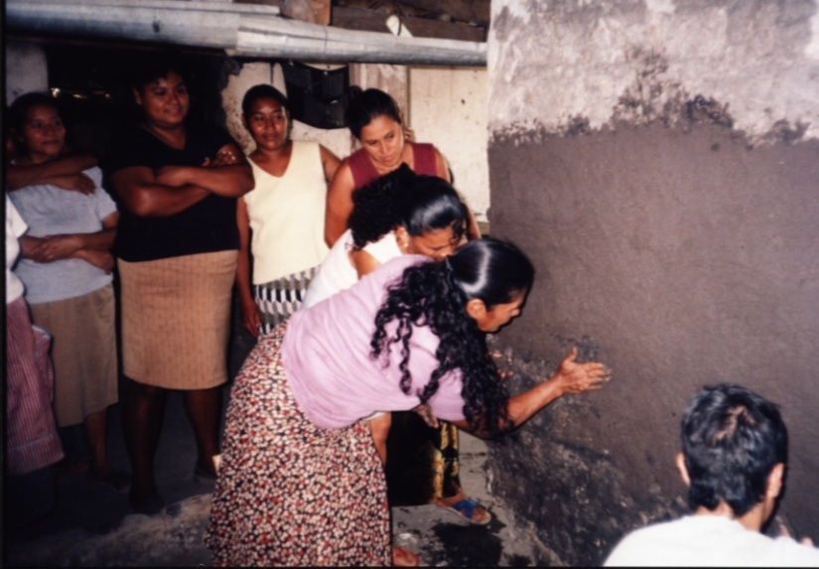
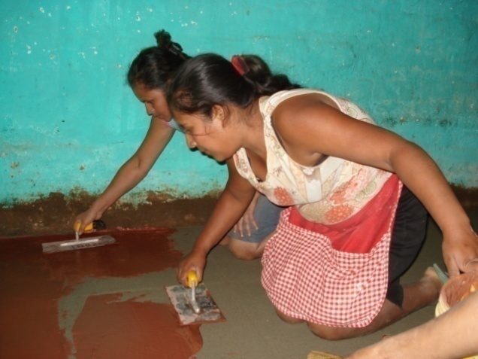
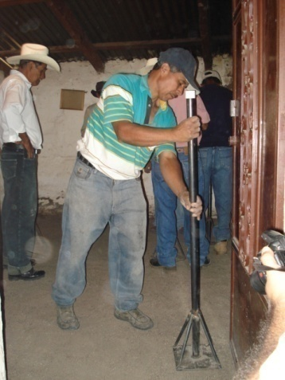
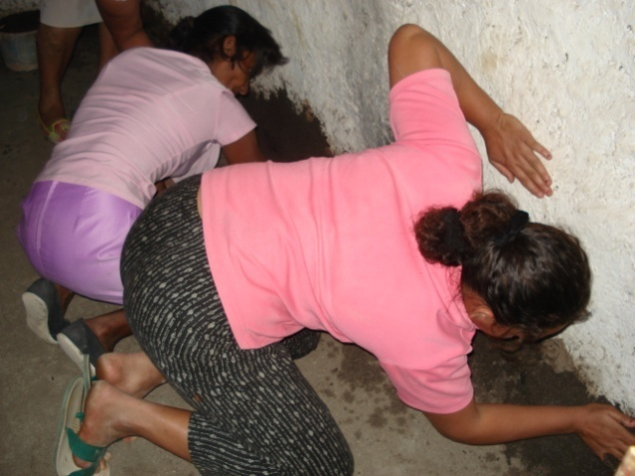
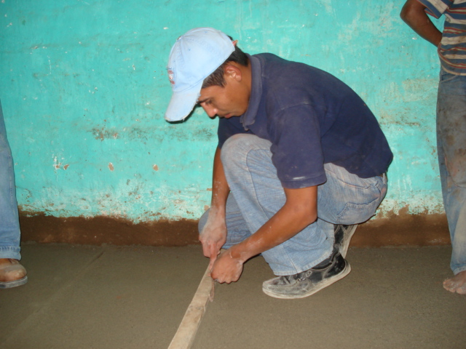
Capacitating for the intervention: Community and Governmental authorities and other stakeholders

Slide 8
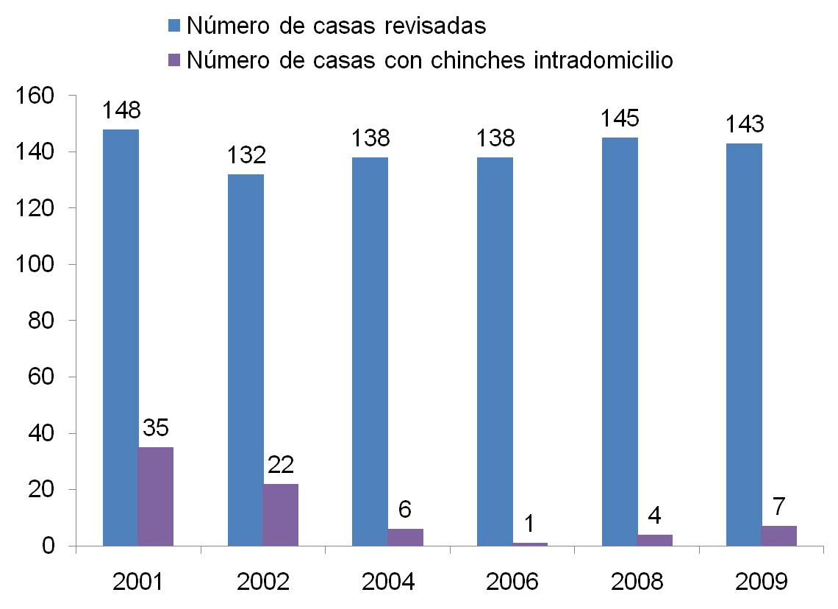
All the houses in the village were searched over the years, man-hour collection method of looking for bugs, analysis of blood sources of the bugs over the years, KAP for the changes in the community knowledge.
Traditional and
Eco-health
interventions……..
Insecticide applications
Eco-health interventions
Porcentaje casas infestadas
23.65%
16.67%
4.35%
0.72%
2.76%
4.90%

Slide 9
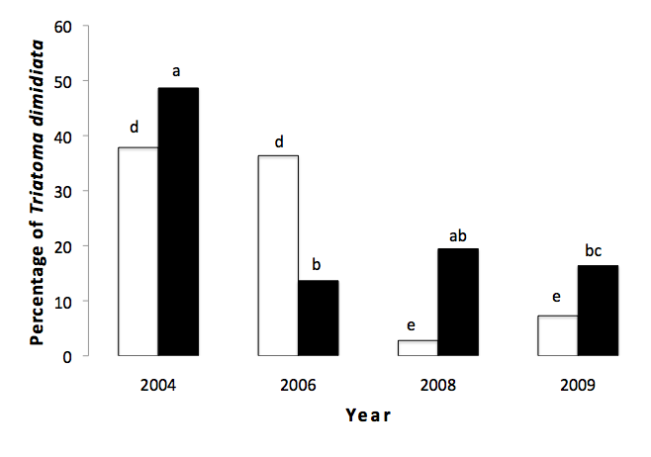
Change of parasite presence and blood sources in the vector after the house improvementes. Villate El Tule Jutiapa, Guatemala

Slide 10
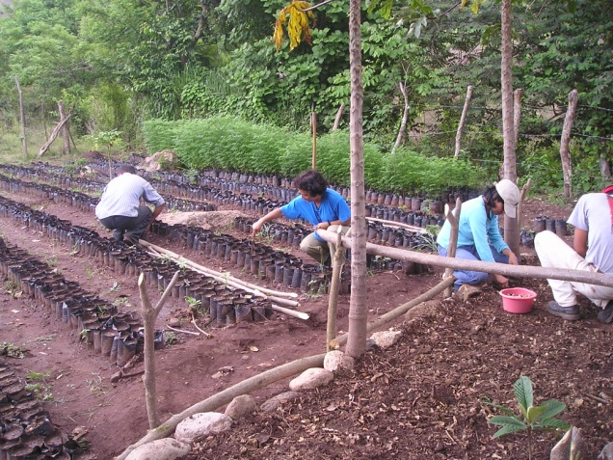
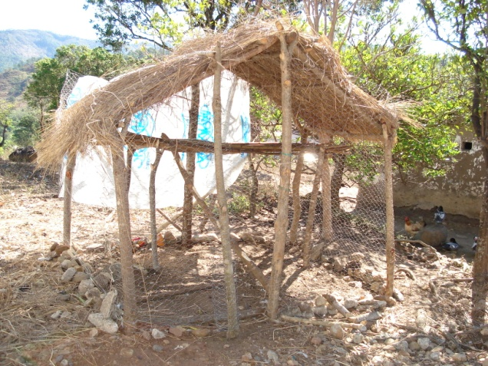
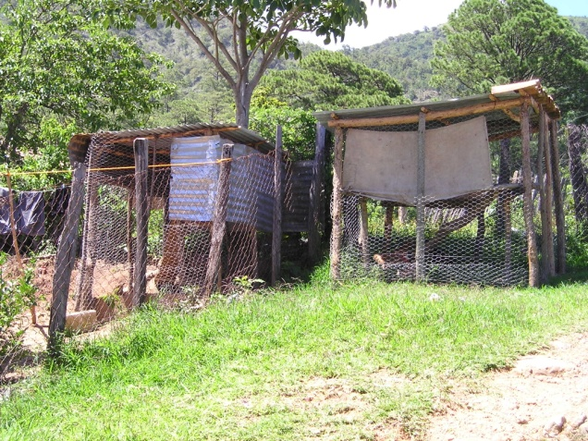
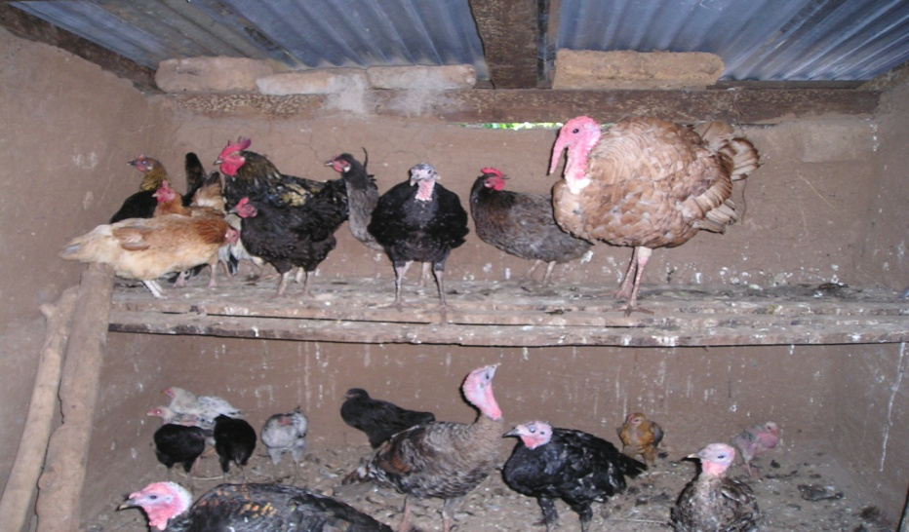
Increase of bird meat consumption and sealing of chickens, while controling the vectos of Chagas disease.

