Slide 1
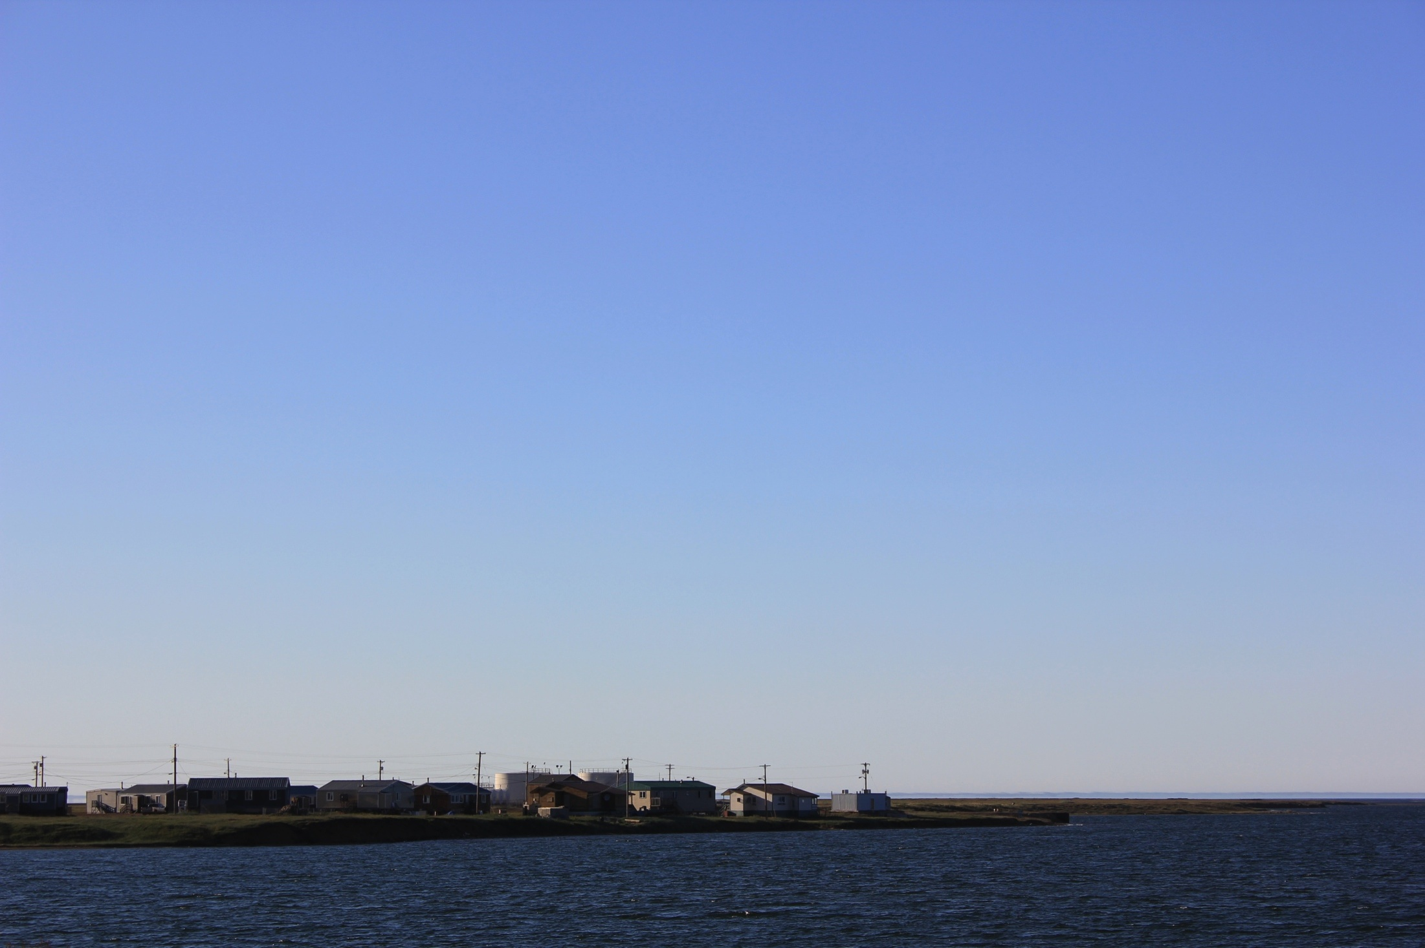
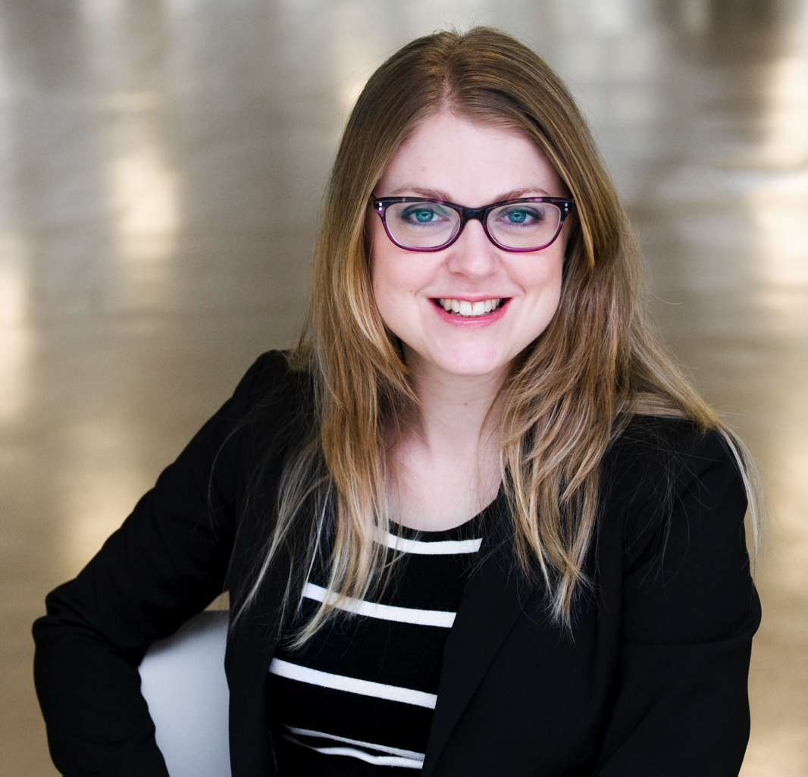
Identification of environmental sources of lead exposure in NUNAVUT (Canada) Using Stable Isotope Analyses
Myriam Fillion^{1,2}, Jules Blais², Emmanuel Yumvihoze¹, Maya Nakajima³, Peter Workman³, Geraldine Osborne³, Laurie Chan¹
1. Centre for Advanced Research in Environmental Genomics, University of Ottawa
2. Department of Biology, University of Ottawa 3. Department of Health, Government of Nunavut
Paper published in Environment International 71 (2014) 63–73
Science Media Centre of Canada Webinar Montréal, Québec August 7, 2014

Slide 2
Background
Blood lead levels (BLL) decreased significantly since the phasing out of lead (Pb) from gasoline in 1970’s
Some groups are still more exposed than others
Human exposure to Pb is still a public health concern: neurotoxic
To date, no safe BLL has been established
Studies suggest that BLL below 50 μg/L may impair neurobehavioral development
Regulation in Canada: Blood lead levels of concern
100 µg/L, currently under review; USEPA recently adopted 50 µg/L
Canadian Health Measures Survey 2009-2011 (national average)
 | Geometric mean | 95th percentile
Adults | 12.0 µg/L | 32.0 µg/L
Children | 7.9 µg/L | 18.0 µg/L

Slide 3
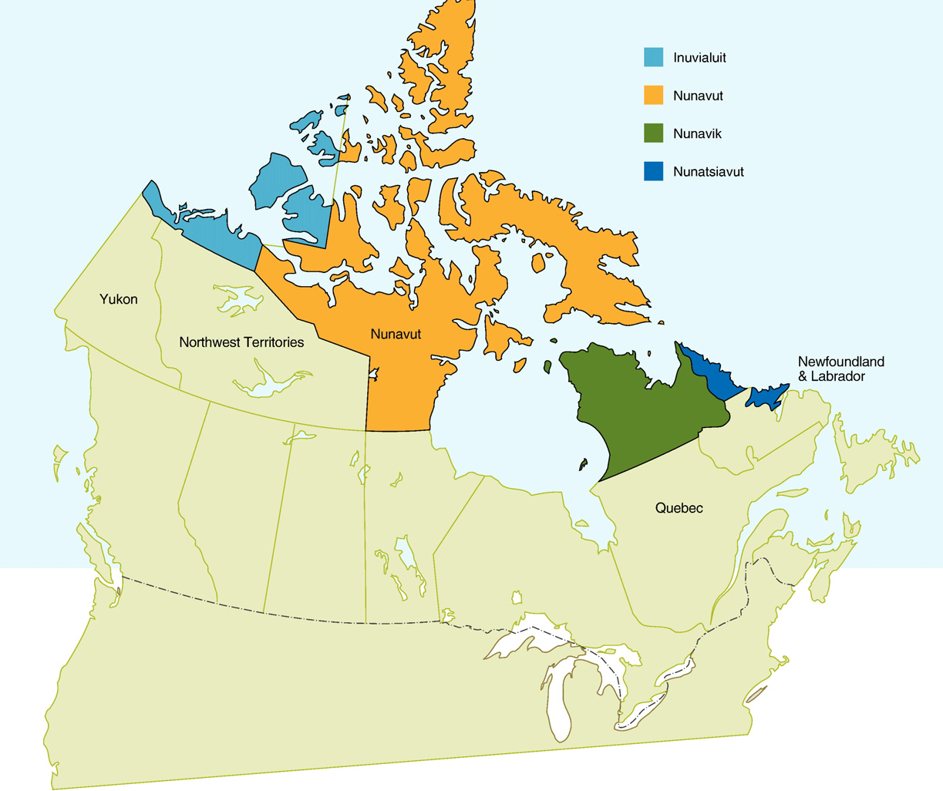
Inuit Health Survey 2007-2008 (IHS)
CCGS Amundsen Icebreaker
Cross-sectional health survey
Stratified random sampling
2 595 Inuit adults
1901 households (68%)
36 communities from Nunavut, Inuvialuit Settlement Region and Nunatsiavut
Results from the IHS
in Nunavut
10% of participants with BLL >100 µg/L
(ITK, 2007)

Slide 4
Objectives of this study
To follow up with the people who had elevated BLL (>100 µg/L) in the IHS 2007-2008 in Nunavut
To explore potential sources of exposure using analyses of lead stable isotopes (²⁰⁴Pb, ²⁰⁶Pb, ²⁰⁷Pb, ²⁰⁸Pb) in blood and environmental samples
Assessment of Pb levels and Pb stable isotope composition
In blood
156 participants (100 adults, 56 children)
In environmental samples (n=172, from 14 houses from 3 communities)
Tap water
Dust
Paint chips
Country food – marine and terrestrial mammals, fish
Ammunition
Soil

Slide 5
Summary of findings
Blood lead levels
Average (geometric mean) = 43.0 µg/L
Higher than the 95th percentile for Canadian population (32.0 µg/L)
BLL increased with age (71.1 µg/L in adults, 17.5 µg/L in children)
Men had higher BLL than women
No gender difference in BLL in children
BLL was >100 µg /L in 35% of the adults and in 1 child
People reporting being involved in hunting activities have higher BLL than those who did not
Among the 90 adult participants who participated in the IHS and this follow-up, BLL significantly decreased between 2007–2008 and 2012

Slide 6
Summary of findings
Lead levels in environmental samples
Country food and soil did not exceed the guidelines for Pb levels
Ammunition samples had elevated Pb levels
Environmental guidelines are good predictors of BLL
When Pb levels in house samples were over the guidelines, BLLs were also likely to exceed the blood lead level of concern
The highest BLLs were from the same households
Houses with the highest Pb levels in dust * Clinical and public health follow-up was completed

Slide 7
Summary of findings
Lead stable isotopes – what are the sources?
Dust, paint, and ammunition had similar lead isotope ratio profiles
Both old paint and ammunition used for hunting could contribute to the household burden of Pb
Indoor dust and ammunition
A main source of Pb among the participants who showed high BLL

Slide 8
Conclusions
For the people who participated to the IHS in 2007-2008 and to this follow-up in 2012, there was a significant decline in BLL
Analyses of lead stable isotopes can identify the environmental sources of human exposure to Pb
Higher Pb in dust: likely source in the households with the highest BLL
Mitigating measures should be developed in order to reduce human exposure to house dust
Renovating houses in poor condition
Developing education campaigns on the safe use of ammunition and maintenance of firearms

Slide 9
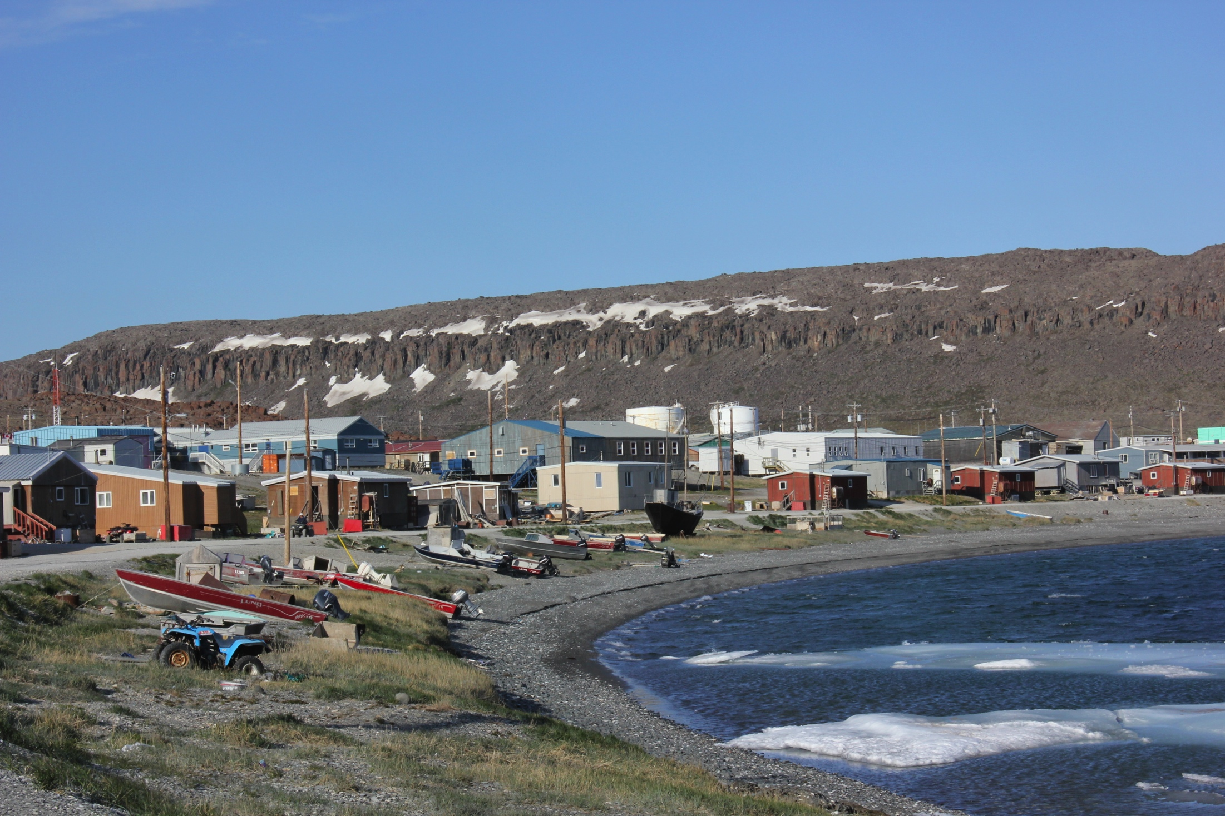
Acknowledgments
Department of Health, Government of Nunavut
CAREG lab technicians and assistants
Contact information
Myriam Fillion
Postdoctoral Fellow
Department of Biology
mfillion@uottawa.ca

