Slide 1
Science Culture:
Where Canada Stands
The Expert Panel on the State of Canada’s Science Culture
Arthur Carty
Marc Lepage
Jay Ingram
August 27, 2014
Council of Canadian Academies
Conseil des académies canadiennes
Science Advice in the Public Interest
Le savoir au service du public
Notes:
Thank you for joining us. Today we are releasing the results of an expert panel assessment regarding the state of Canada’s science culture. It was conducted by a 14 member expert panel. It was an independent exercise that had us review relevant literature, data and conduct a survey of 2,000 Canadians. This work now gives us the clearest picture of Canada’s science culture and support system in 25 years.
It is important to note, We were asked to look at the informal systems that make up Canada’s science culture system. We did not evaluate specific programs or make conclusions regarding science education or government policies.

Slide 2
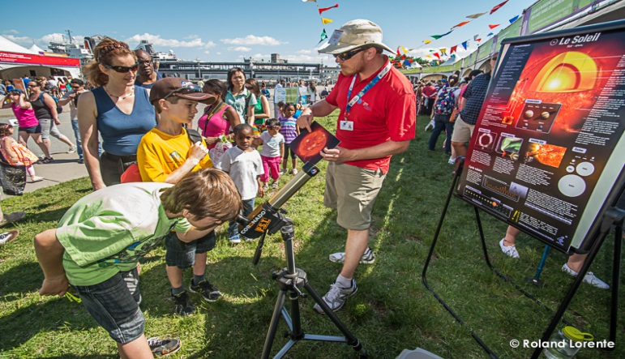
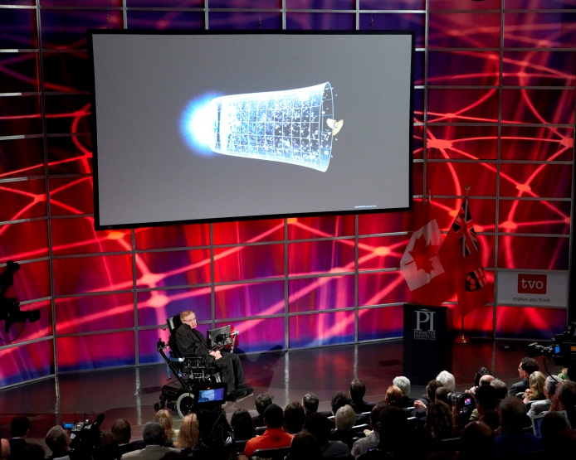
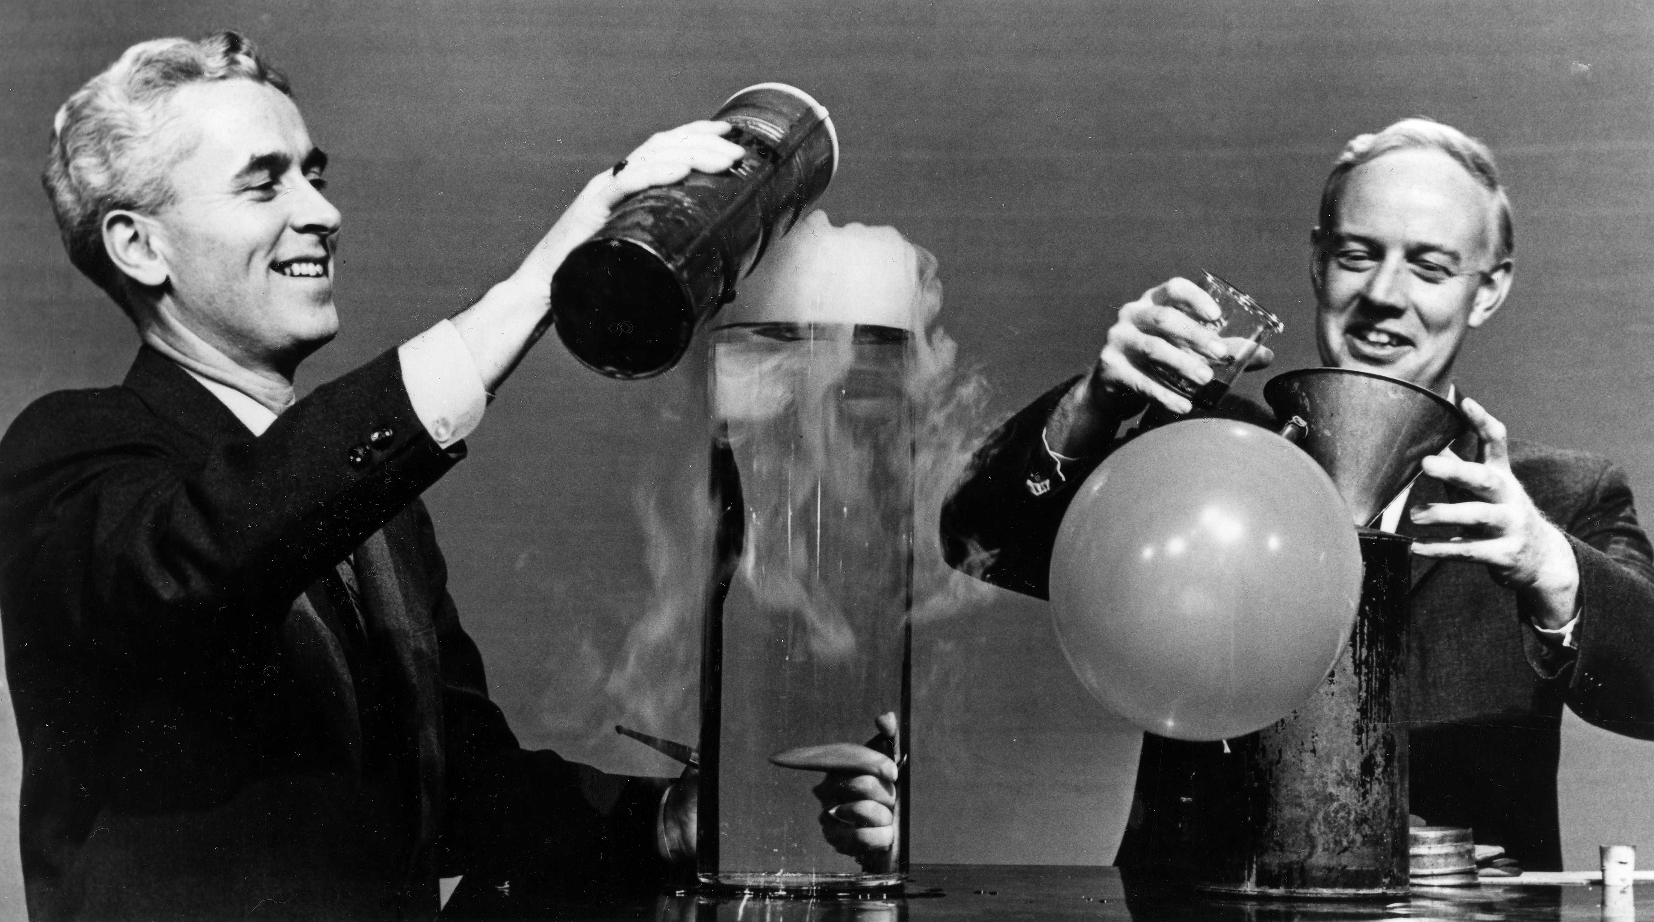
Canadians rank highly when it comes to science knowledge, attitudes & engagement
“Canadians perform well across a range of science culture indicators. However, it is important that we continue to strive for a society that looks to science to help inform our decisions and broaden our world view.”
Dr. Arthur Carty, O.C., Expert Panel Chair
Notes:
ART CARTY
Overall, the evidence we looked at shows that Canada has a strong science culture, with many ordinary Canadians interested and actively engaged in learning about science. However, there are some gaps and areas for improvement and during our briefing we will speak to how we compare internationally, trends we took note of and opportunities and strengths.

Slide 3
Defining Science Culture
A society has a strong science culture when it embraces discovery & supports the use of scientific knowledge & methodology. Such a culture encourages the education and training of a highly skilled workforce and the development of an innovative knowledge-based economy.
Notes:
ART CARTY
One of the first challenges the panel faced was defining science culture.
While not uncommon in Canada, the term is rarely defined with precision.
It most often is used to indicate the overall degree to which society is broadly engaged in and supportive of science.
As understood by this Panel, a society with a strong science culture is one that embraces discovery and supports the use of scientific knowledge and methodology. Such a culture encourages the education and training of a scientifically skilled workforce and the development of an innovative knowledge-based economy.
To come to this definition, the Panel looked at the available literature on the term “science culture”, as well as examples of similar terms used in other countries including “science literacy” and “public understanding of science.” This review of evidence helped to shape the Panel’s understanding of what science culture is and what it means in the Canadian context.

Slide 4
Assessing Science Culture
Science culture is multidimensional and has four key dimensions.
Public Attitudes Towards Science
Public Science Engagement
Public Science Knowledge
Science & Technology Skills
Notes:
ART CARTY
The Panel also recognized that science culture is a multidimensional concept, intended to capture many different elements in how people engage and relate to science.
In assessing Canada’s science culture, the Panel focused specifically on four of these dimensions:
Public attitudes towards science: what are people’s attitudes towards science?
Public engagement in science: how do people engage and interact with science? How interested are they in scientific developments? Do they pursue scientific activities and hobbies?
Public science knowledge: how much do Canadians know about science? Do they understand key scientific concepts and methods?
Science and technology skills: to what extent are Canadians developing advanced science and technology skills? Are they pursuing education and career opportunities in the sciences?

Slide 5
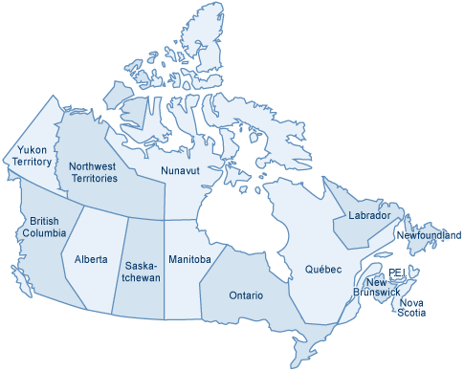
The Panel’s Survey
Survey of over 2,000 randomly-selected Canadians
Carried out in April, 2013
Conducted by EKOS Research, Inc.
Included combination of landline, mobile, and internet respondents
Results weighted by age, region, gender, and education to be representative of the national population.
Accurate nationally +/- 2.2% at 95% confidence interval
Designed to be comparable with:
International surveys (US, EU, Japan, China, India, Brazil, Russia)
1989 survey of Canadians
Notes:
ART CARTY
What I think many of us are most excited about is the survey we conducted. It provides new and current data on science culture in Canada. The last time such a survey was done it was 25 years ago.
The survey was a key source of evidence for us and helped us to respond with greater insight to the Panel’s charge.
Many countries regularly conduct surveys of public attitudes, understanding, and engagement in science; however there is very little of this kind of data for Canada.
As a result, the Panel undertook a new survey of over 2,000 randomly selected Canadians.
The survey was designed to be compatible with other surveys internationally as well as with a 1989 Canadian survey, thereby allowing analysis of changes over time.
The survey included a combination of landline, mobile, and internet respondents; and results were weighted to be representative of the national population.
The results of this survey now give a baseline from which to work, and a good impression regarding science attitudes, knowledge, and engagement in Canada.
Ultimately, the survey gives comprehensive insight into the state of Canada’s science culture that otherwise did not exist. For some, it may come as a surprise that Canada has a very good science culture and individuals and families are positive about science and engaging with science on a regular basis.

Slide 6
Attitudes & Reservations Towards S &T
The Public have positive attitudes & low reservations about S&T
Attitudes towards the promise of science
Science and technology are making our lives healthier, easier, and more comfortable.
With the application of science and new technology, work will become more interesting.
Because of science and technology, there will be more opportunities for the next generation.
It is not important for me to know about science in my daily life.
We depend too much on science and not enough on faith.
Science makes our way of life change too fast.
Reservations about science
% Agree
72
67
74
17
25
35
Notes:
Jay Ingram
There are now a relatively standard set of survey questions that have been used to explore public attitudes towards science in many countries.
Past research on these questions has found that attitudes towards science and technology are two-dimensional.
One dimension captures people’s perceptions about the promise of science and technology…
A separate dimension captures people’s reservations about science, or the risks or negative repercussions arising from science.
Studies from other countries have shown that these dimensions are not always correlated…people sometimes express both strongly positive views about science and significant reservations about science and its impacts on society.
In Canada what we are seeing is positive attitudes and low reservations.

Slide 7
Public Engagement in Science
Indicator | % | Rank
% of pop. interested in new scientific discoveries and technological developments | 93 | 1st out of 33 countries
% of pop. that visited a S&T museum at least once in previous year | 32 | 2nd out of 39 countries
% of pop. that signs petitions or joins street demonstrations on matters of nuclear power, biotechnology, or the environment | 23 | 3rd out of 33 countries
% of pop. that attends public meetings or debates about science and technology | 14 | 5th out of 33 countries
% of pop. that participates in activities of an NGO dealing with science/technology related issues | 14 | 1st out of 33 countries
% of pop. donates to fundraising campaigns for medical research | 63 | 7th out of 33 countries
Notes:
Jay Ingram
In the Panel’s survey, 93% of Canadians reported being interested in new developments in science and technology. Canada ranked 1st among 33 countries on this measure.
32% of Canadians reported visiting a science or technology museum in the last year. Canada ranks second on this measure, after Sweden.
Canadians area also highly engaged in other ways, such as participating in the NGOs related to science and technology, or attending public lectures and debates.
The survey also documented that Canadians are increasingly relying on online sources in seeking out new information on science and technology.

Slide 8
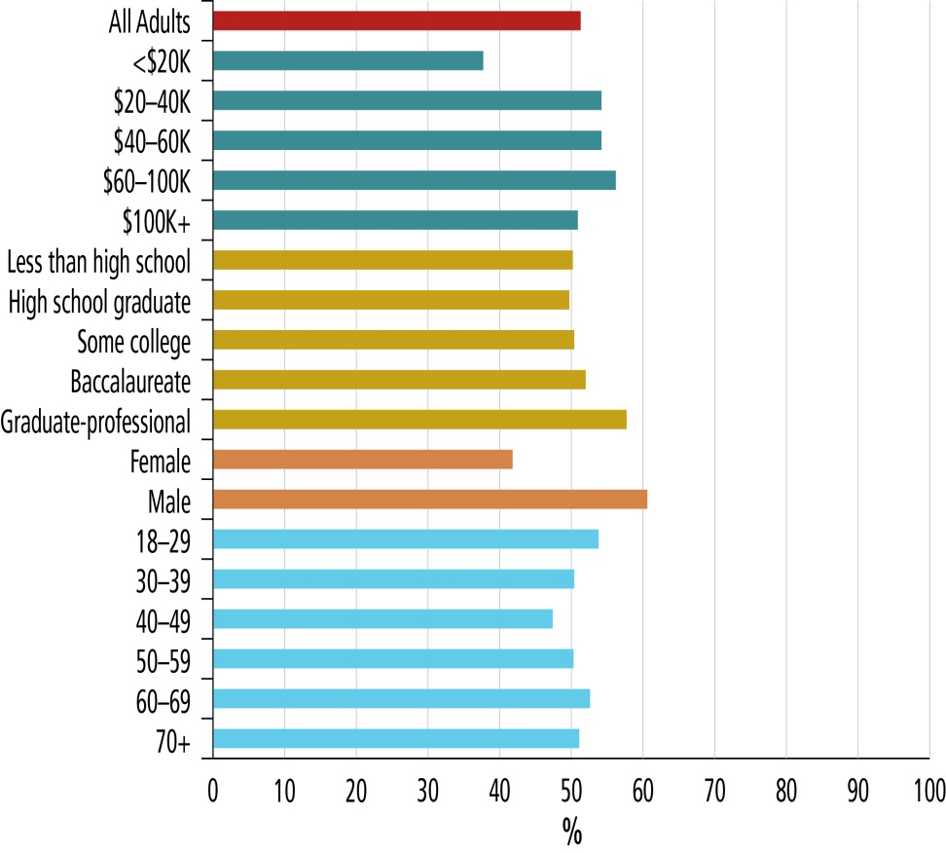
Drivers of Interest in Science
Canadian Interest in Science by Demographic Group
Interest in science is higher among:
Younger respondents
More educated respondents
Higher income respondents
Men vs. women
Similar patterns found in demographic drivers for other science culture dimensions.
Data Source: Panel survey data
Notes:
Jay Ingram
The Panel’s survey data was also used to explore some of the demographic drivers of interest in science and other aspects of science culture.
In general the patterns that emerged were expected and consistent with other countries.
Interest in science is higher among
Younger respondents
More educated respondents
Higher income respondents
And men
Gender has the most pronounced effect – 60% of men vs.40% of women indicated that they were very interested in science and technology.
Similar findings are evident in the demographic drivers of science knowledge and attitudes.

Slide 9
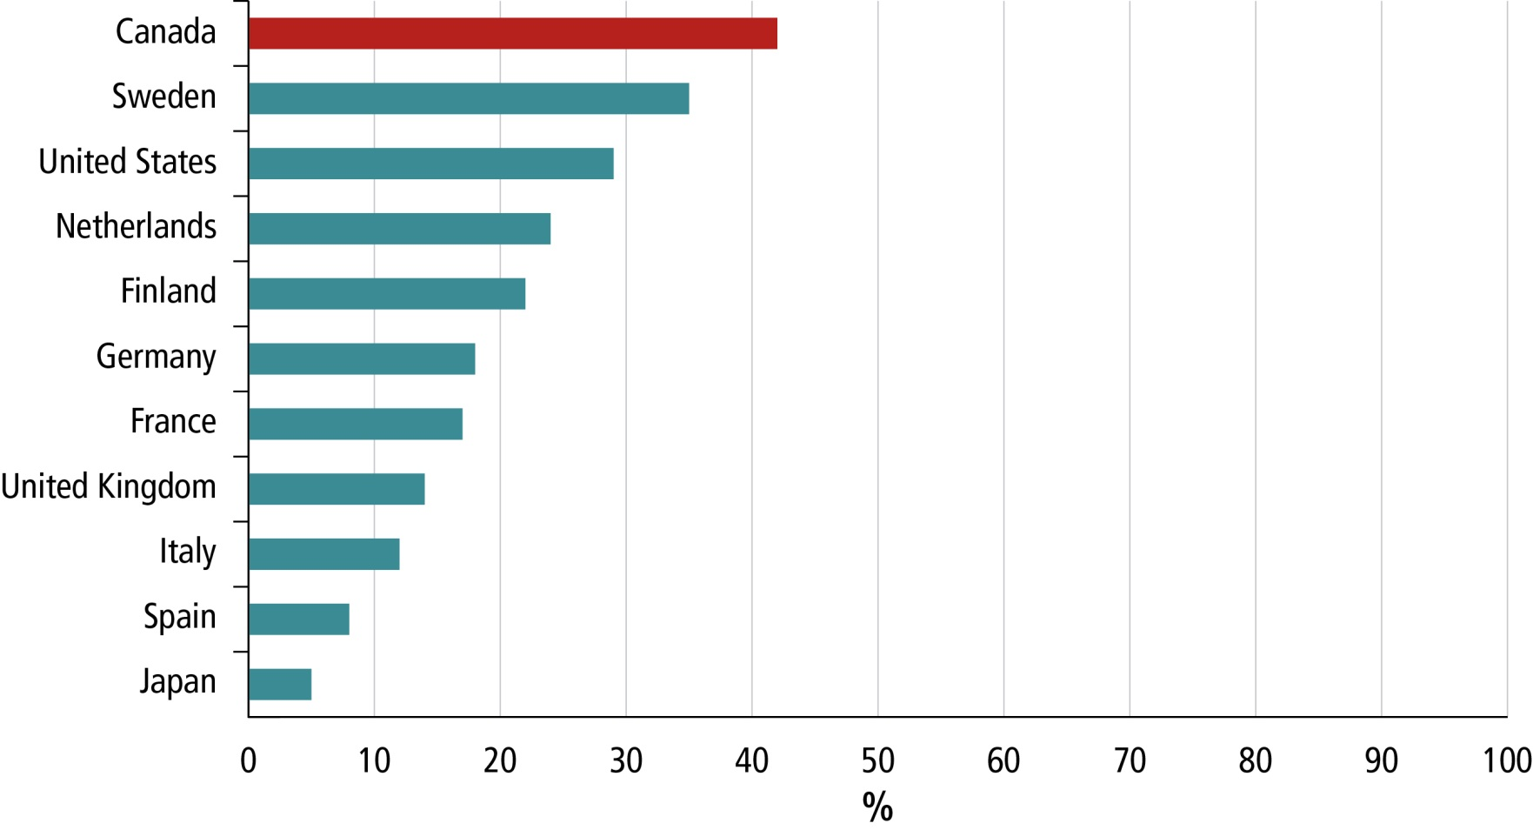
Measuring Science Literacy
Civic Science Literacy by Country
Canada ranks 1st out of all countries on a science literacy index based on these factual and open-ended survey questions.
Notes:
Jay Ingram
When compared to other countries on a set of true and false and open ended questions on key scientific terms, Canadians do very well.
Based on an index incorporating all of these questions, Canada has the highest level of public science literacy of all countries for which there is data.
According to this measure, roughly 42% of Canadians have the level of science literacy needed to understand much of the coverage of science and technology stories reported in the press.
This result, however, should be interpreted with caution as Canadian data is more recent than the data for other countries, and science literacy in all countries seems to be improving over time.
Nevertheless, the results clearly suggest that Canada has a relatively high level of public science knowledge in comparison with other countries.

Slide 10
Public Science Knowledge
Canadian Science Knowledge, 2013
Data Source: Panel survey data
Some Canadians struggled to correctly answer true or false questions on various science terms and facts.
Notes:
Jay Ingram
However, it is also true that many Canadians are still unable to correctly answer basic true or false questions about science.
For example, only 53% of Canadians know that antibiotics do not kill viruses. Likewise nearly half of Canadians incorrectly believe that lasers are caused by focusing sound waves.
However, these results still reflect some good news. Compared to responses from a 2010 American survey with the same questions, Canadians perform better on all but one question.

Slide 11
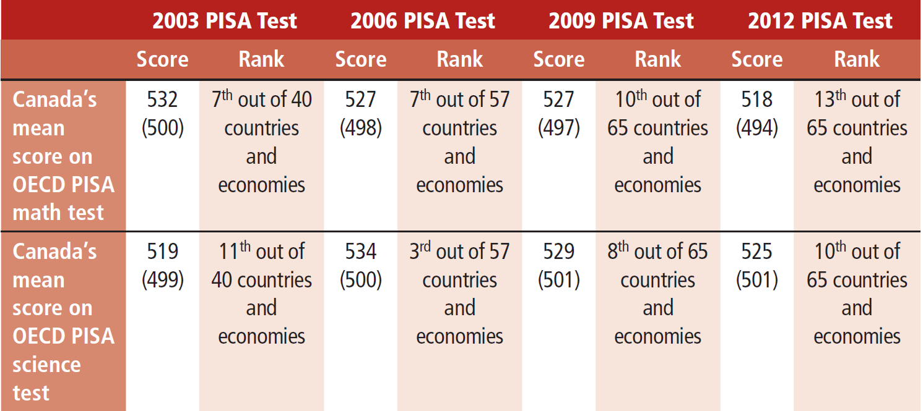
Canadian PISA Science and Math Scores, 2003-2012
Canadian Students Scientific Knowledge,
Internationally Strong But Declining
Canadian students perform well on international assessments of science and mathematics ranking second among G7 countries
However, since 2006, Canada’s PISA scores and rank have declined, raising concerns about future performance
Notes:
Art Carty
Declining PISA scores in math and science also raise concerns that science education in Canada may not be keeping pace with other comparator countries.
Canadian students perform well on international assessments of science and mathematics ranking second among G7 countries
However, since 2006, Canada’s PISA scores and rank have declined, raising concerns about future performance
Although we still do well, we can’t become complacent.

Slide 12
Science Culture Trends: 1989 - 2013
Since an earlier Canadian survey in 1989:
Public science knowledge increased
Public science engagement increased
Public reservations about science declined
University science and engineering enrollments are stable
…however:
Canadians are more skeptical about science’s ability to solve social problems
Declining PISA scores in science and math are cause for concern
Notes:
Art Carty
The Panel’s survey was also designed to allow comparisons with Canadian data from 1989.
In general, most of the trends revealed suggested a strengthening of Canada’s science culture over time.
Reservations about science have declined
Engagement about science has increased.
Public knowledge about science has improved.
Canadian enrollment in university science courses is stable.
Some data, however, also points to more concerning trends.
Canadians have recently become somewhat more skeptical about the ability of science and technology to address common social problems.
Declining PISA scores in math and science also raise concerns that science education in Canada may not be keeping pace with other comparator countries.

Slide 13
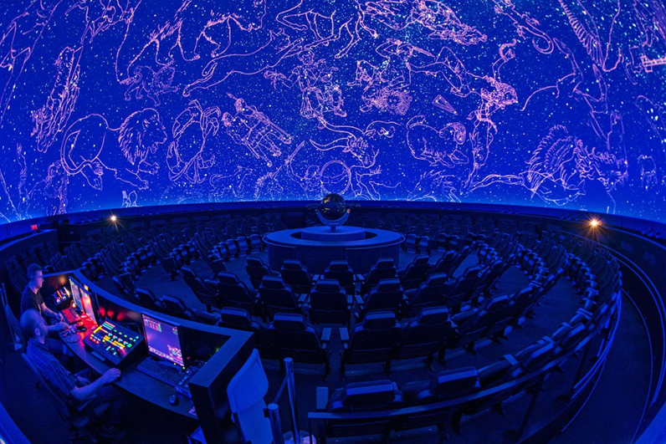
Institutional and Social Support
Canada has a diverse constellation of organizations, programs, and initiatives that support science culture, including over:
400 initiatives related to science centres/museums, zoos, aquariums.
64 associations and NGOs
49 educational initiatives
60 government policies and programs,
27 media programs.
Rio Tinto Planetarium, Montreal
The Yukon Beringia Interpretive Centre, Whitehorse
Notes:
Marc LePage
As part of its charge, the Panel also explored the institutional and social support system for science culture in Canada.
Given a lack of internationally comparable data in this area, the Panel’s analysis here was more descriptive than analytical, building on a comprehensive inventory of science culture organizations, programs, and initiatives.
Clearly, there is a wide range of sources of support for science culture in Canada. A 2011 inventory examined by the Panel identified over:
400 initiatives related to science centres/museums, zoos, aquariums.
64 associations and NGOs
49 educational initiatives
60 government policies and programs,
27 media programs.
What we can glean from all of this is that there is an appetite for science by Canadians across the country. That Canadians want to experience science and absorb it through informal and formal ways. This is something that is positive and we can all be excited by.

Slide 14
Cultivating a Strong Science Culture
Promising interventions organized under five themes:
Supporting Lifelong Science Learning
Need for effective formal science education system; and
Making Science Inclusive
Target existing inequalities
Adapting to New Technologies
All science culture supporters are adapting to new technologies
Enhancing Science Communication and Engagement
Providing National or Regional Leadership
Informal science learning resources that adults continue to access throughout their lives.
Adapt learning and engagement strategies to the cultural context and audience
Use new technologies to connect to new audiences, customize learning
Create incentives for public science communication
Engage the public in areas of science decision-making
Acknowledge controversy and debate
Use connections between science and the arts
Provide leadership and vision
Articulate a framework for coordination and information sharing
Celebrate science
Support science education in the school system
Adjust to changing business models
Notes:
Marc LePage
Much can be done to strengthen science culture in any society, and a large number of practices are applicable. In reviewing the evidence in this area, the Panel identified promising interventions under five broad themes.
Supporting Lifelong Science Learning: Ensuring the availability of a variety of informal science learning opportunities in tandem with formal, in-class settings.
Making Science Inclusive: Tailoring science learning and engagement to the social and cultural contexts of traditionally underrepresented groups, such as women and aboriginal communities.
Adapting to New Technologies: Using new communication technologies, such as social media, to enhance science outreach initiatives and offer new modes of public engagement.
Enhancing Science Communication and Engagement: Encouraging communication and engaging the public in areas of science decision-making to make science more relevant to society and increase science knowledge by encouraging debate and linking science with other areas such as the arts.
Providing National or Regional Leadership: Articulating a vision for science that provides a framework for action and a foundation for coordination among various organizations.

Slide 15
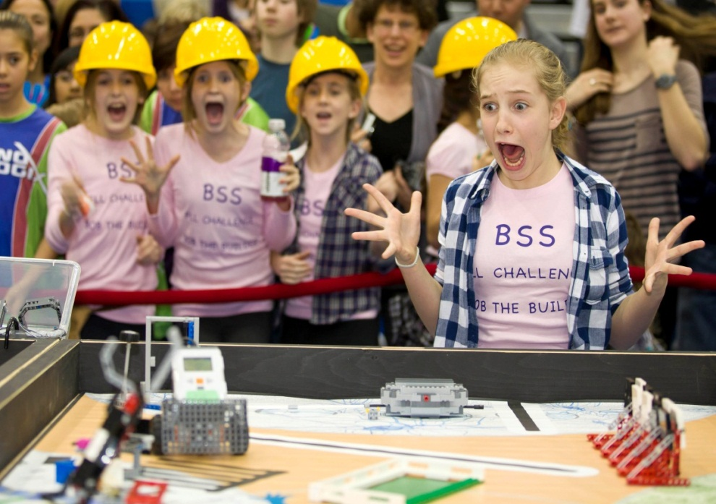
Final Reflections
Science culture is also about ensuring that all individuals and all segments of society have opportunities to share in the wonder and excitement of science.
Canada has a strong science culture in many respects.
However, there is room for improvement.
Many Canadians struggle to explain key scientific concepts which could make it difficult to follow important public issues.
Canada can continue to learn from initiatives in other countries, develop more regular and robust approaches to assessing science culture.
FIRST Lego League Competition
Developing a strong science culture in Canada remains a work in progress.
Notes:
Marc LePage
To conclude, much of the evidence reviewed by the Panel suggests that Canada benefits from a strong science culture relative to its peers.
However it is equally clear that there is considerable room for improvement. Most Canadians still lack the basic understanding of science needed to understand current science and technology issues and participate in an informed manner in public debates about these subjects.
Developing a science culture, however, is also about celebrating the wonder and excitement of science. In this respect, more can also be done to ensure that all Canadians have opportunities to experience this wonder and excitement. As a result, developing a strong science culture for Canada remains a work in progress.

Slide 16
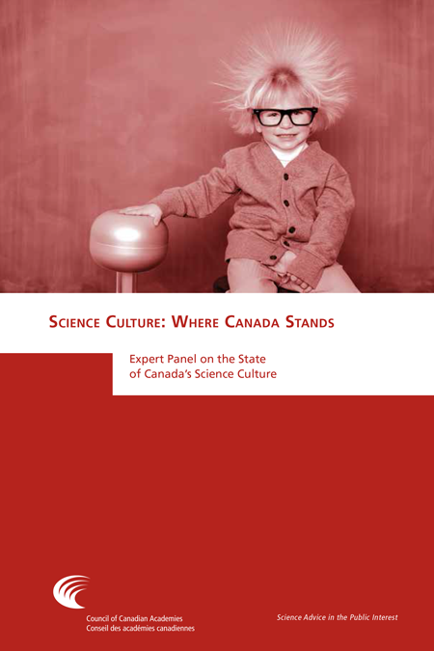
Thank you
The full report is available for download from the Council’s website, www.scienceadvice.ca
Council Contact: Cathleen Meechan, cathleen.meechan@scienceadvice.ca
SMCC Contact: Tyler Irving, tyler.irving@sciencemedia.ca
Council of Canadian Academies
Conseil des académies canadiennes
www.scienceadvice.ca
www.sciencepourlepublic.ca
@scienceadvice

