Slide 1


Slide 2

Webinar on the IPCC Fifth Assessment Report - Working Group I: The Physical Science Basis of Climate Change
Friday, September 27, 2013 at 1 PM ET

Slide 3
Expert panel
Francis Zwiers
Director of the Pacific Climate Impacts Consortium
Howard Freeland
Physical Oceanographer and Emeritus Scientist, Fisheries and Oceans Canada
Graham Cogley
Professor Emeritus of Geography, Trent University
Xuebin Zhang
Research Scientist at Environment Canada

Slide 4
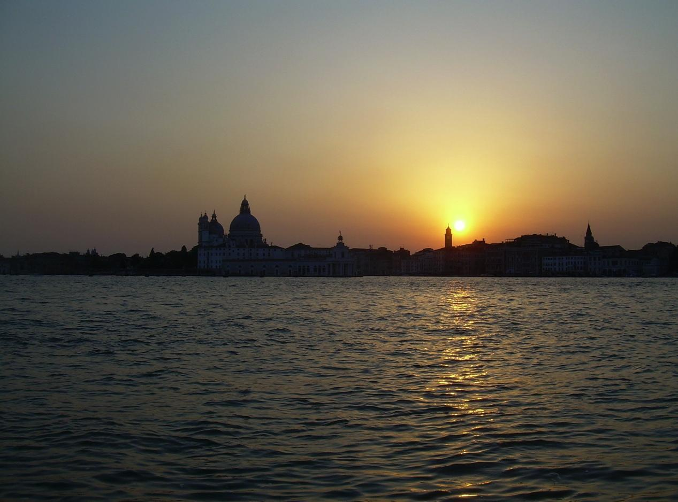
The IPCC 5th Assessment Report
Background
Francis Zwiers
Pacific Climate Impacts Consortium
University of Victoria, Victoria, BC, Canada
Photo: F. Zwiers
Wosk Centre, 30 Sept 2013

Slide 5
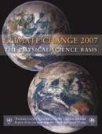

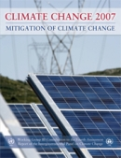
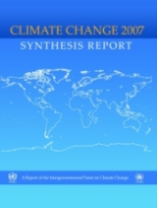
History
The IPCC was established in 1988
  Joint UNEP and WMO sponsorship
  Currently 195 member countries
Major assessment reports
  1990, 1995, 2001, 2007, 2013/2014
Assessments in three broad areas
  WG1 – The Physical Science Basis
  WG2 – Impacts, Adaptation and Vulnerability
  WG3 – Mitigation
Plus a Synthesis Report

Slide 6
The Fifth Assessment Report
Scope determined in 2009
Authors and Review Editors selected in 2010
  More than 830 scientists in total (259 for WG1)
Scheduled completion dates
    WG1 (Physical Science Basis): 27 Sept 2013
    WG2 (Impacts, Adaptation, Vulnerability): 30 March 2014
    WG3 (Mitigation): 12 April 2014
    Synthesis Report: 1 November 2014
Approval/acceptance
  Line-by-line approval of the Summary for Policymakers
  Acceptance of the underlying report

Slide 7
The Fifth Assessment Report
Three stage review process
  Expert review of the 1st order draft
  Government and Expert review of the 2nd order draft
  Government review of draft Summary for Policymakers
Transparency
  Review process was open to all experts (required registration and a declaration of expertise)
  Authors respond to all comments
For WG1
  54677 comments
    1089 expert reviewers from 55 countries and 38 governments

Slide 8
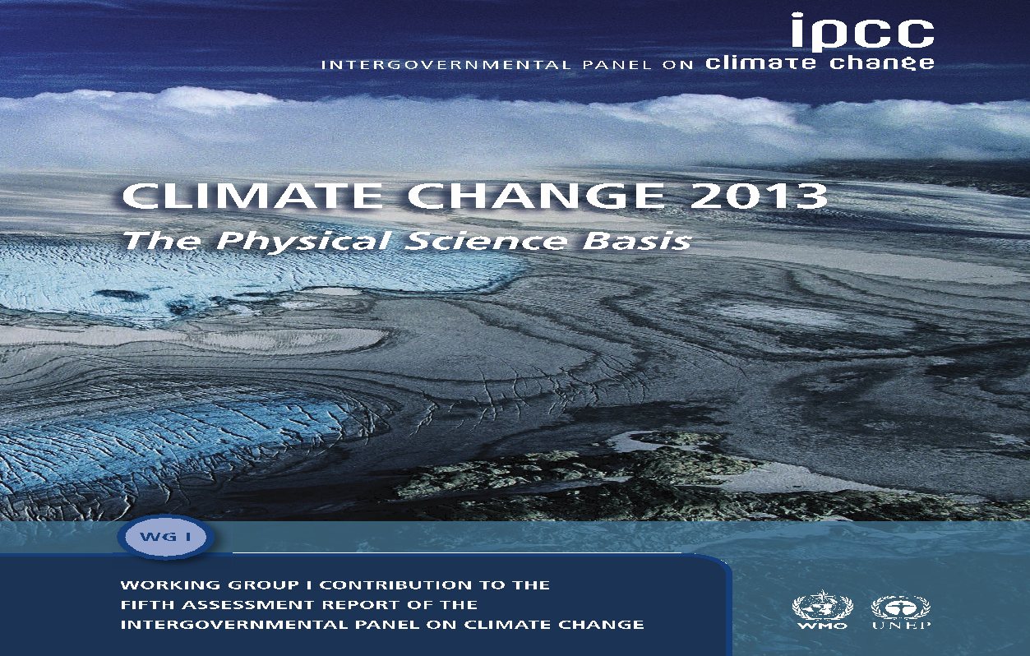
http://www.climatechange2013.org

Slide 9
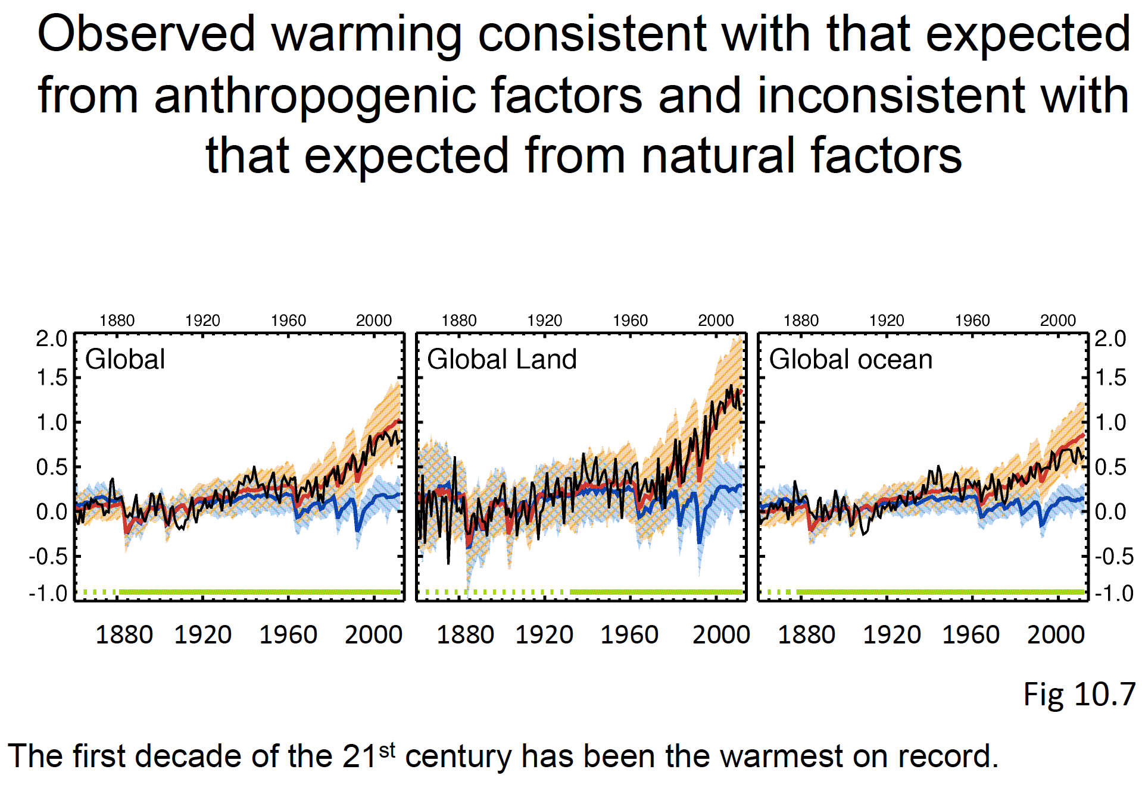

Slide 10
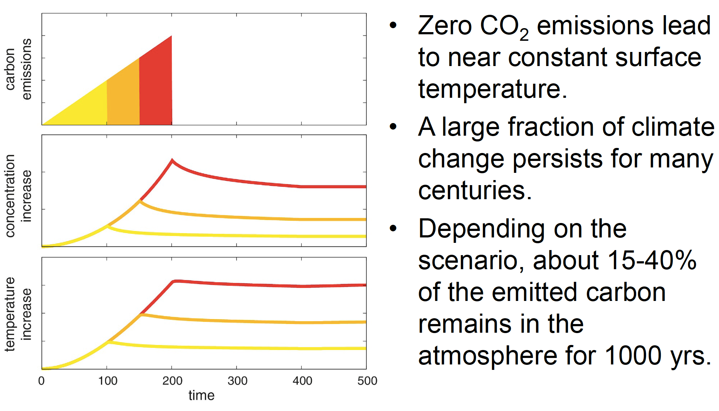
Warming will persist for centuries
Courtesy R. Knutti

Slide 11
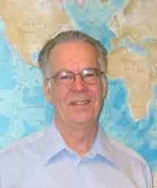
1
Howard Freeland
Howard.Freeland@dfo-mpo.gc.ca
Current affiliation and address:
Emeritus Scientist
Fisheries and Ocean Canada
Institute of Ocean Sciences
P. O. Box 6000
Sidney, BC, V8L 4B2
IPCC Role:
Review Editor on Chapter 3 - Observations: The Oceans
IPCC WG1 AR5

Slide 12
What does AR5 say about our oceans?
2
They are absorbing most of the additional heat (and we have better estimates of this)
Sea levels are rising (and we have better evidence for this)
Changes in precipitation/evaporation are leading to changes in salinity
Changes in pH also evident

Slide 13
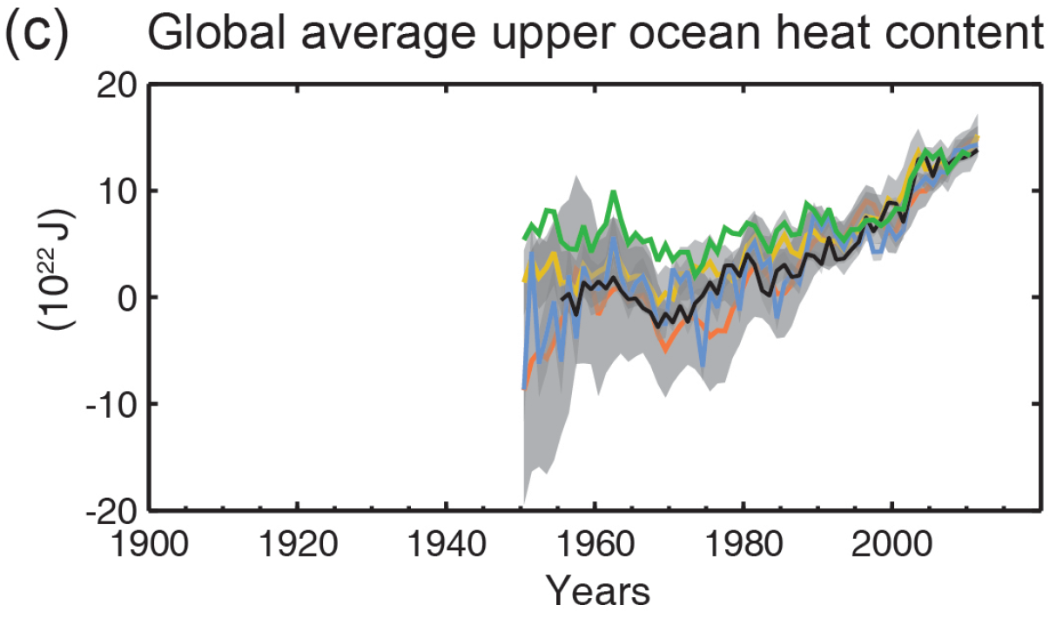
Oceans are storing more heat
4
Heat content of the upper (0-700m) ocean increased from 1971 to 2010.
AR4 suggested that abyssal (3000+m) waters were warming; this has now been shown to be occurring in all ocean basins. Changes are small, but the volume of water affected is huge.
Figure 2c from IPCC AR5 Summary for Policymakers

Slide 14
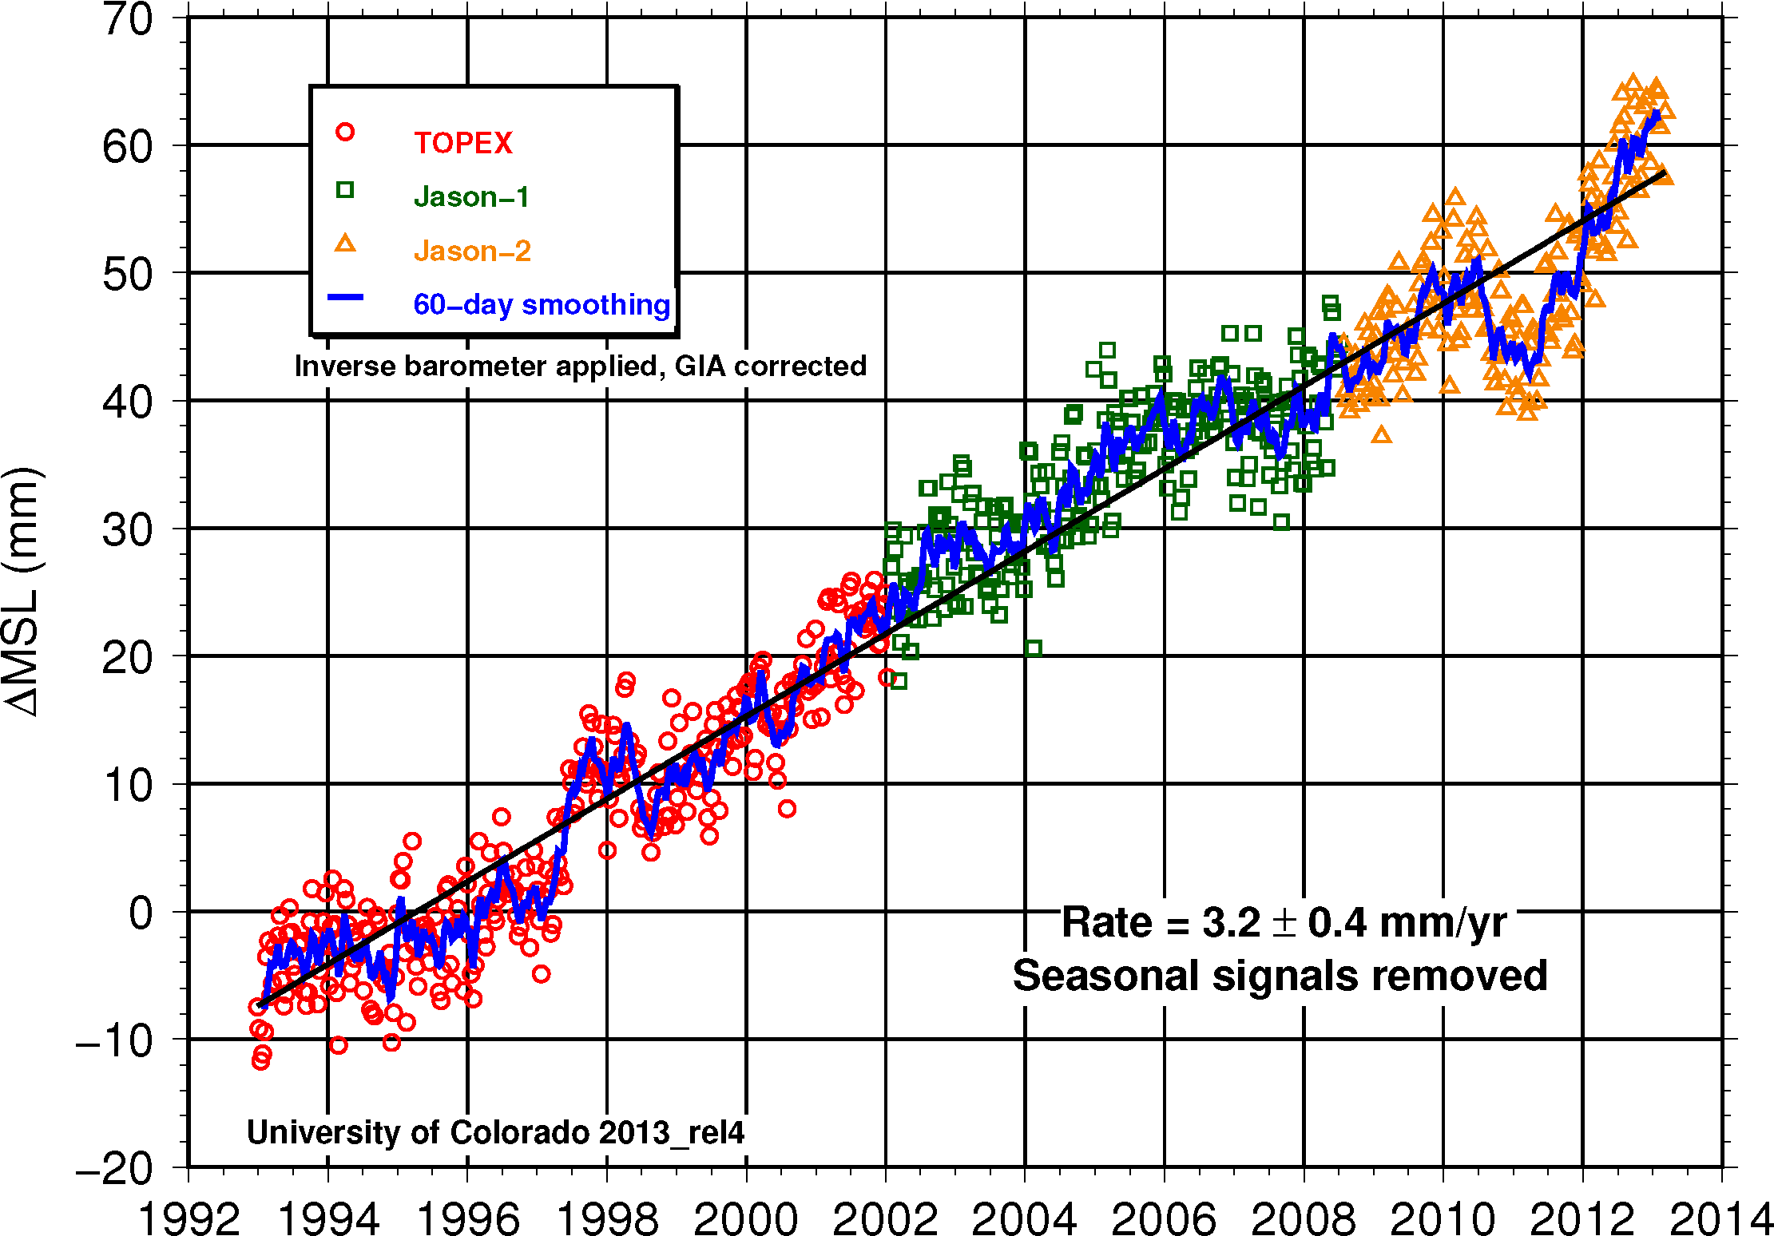
Satellite data shows rising sea levels
5
Sea levels rise either because of melting ice or expansion of existing water; BOTH require heat input.
This is the overwhelming evidence that the Earth is warming.
Diagram from: http://sealevel.colorado.edu/

Slide 15
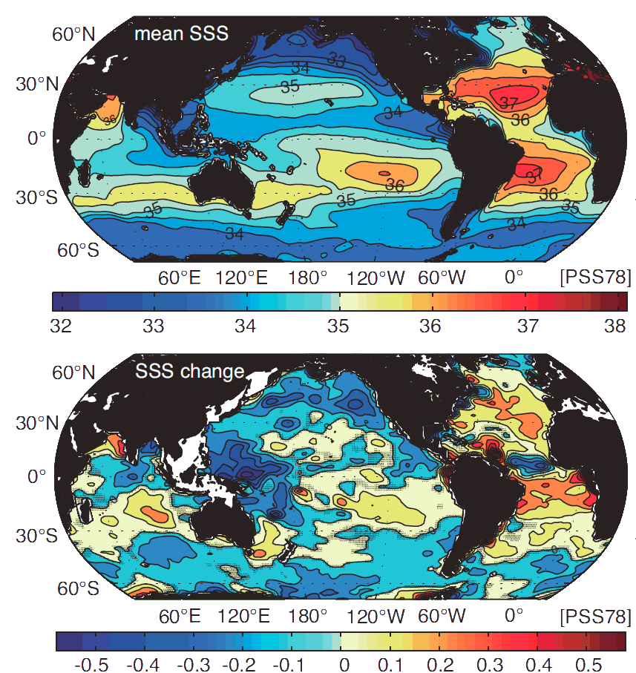
Ocean buoys show salinity changes
6
Salty areas are getting saltier; fresh areas are becoming fresher
This is due to changes in precipitation/ evaporation
Durack, Paul J., Susan E. Wijffels, 2010: Fifty-Year Trends in Global Ocean Salinities and Their Relationship to Broad-Scale Warming. J. Climate, 23, 4342–4362.

Slide 16
7
Ocean acidification
The pH of seawater has decreased by 0.1 since the industrial revolution
This means 26% increase in hydrogen ions (H⁺) (logarithmic scale)

Slide 17
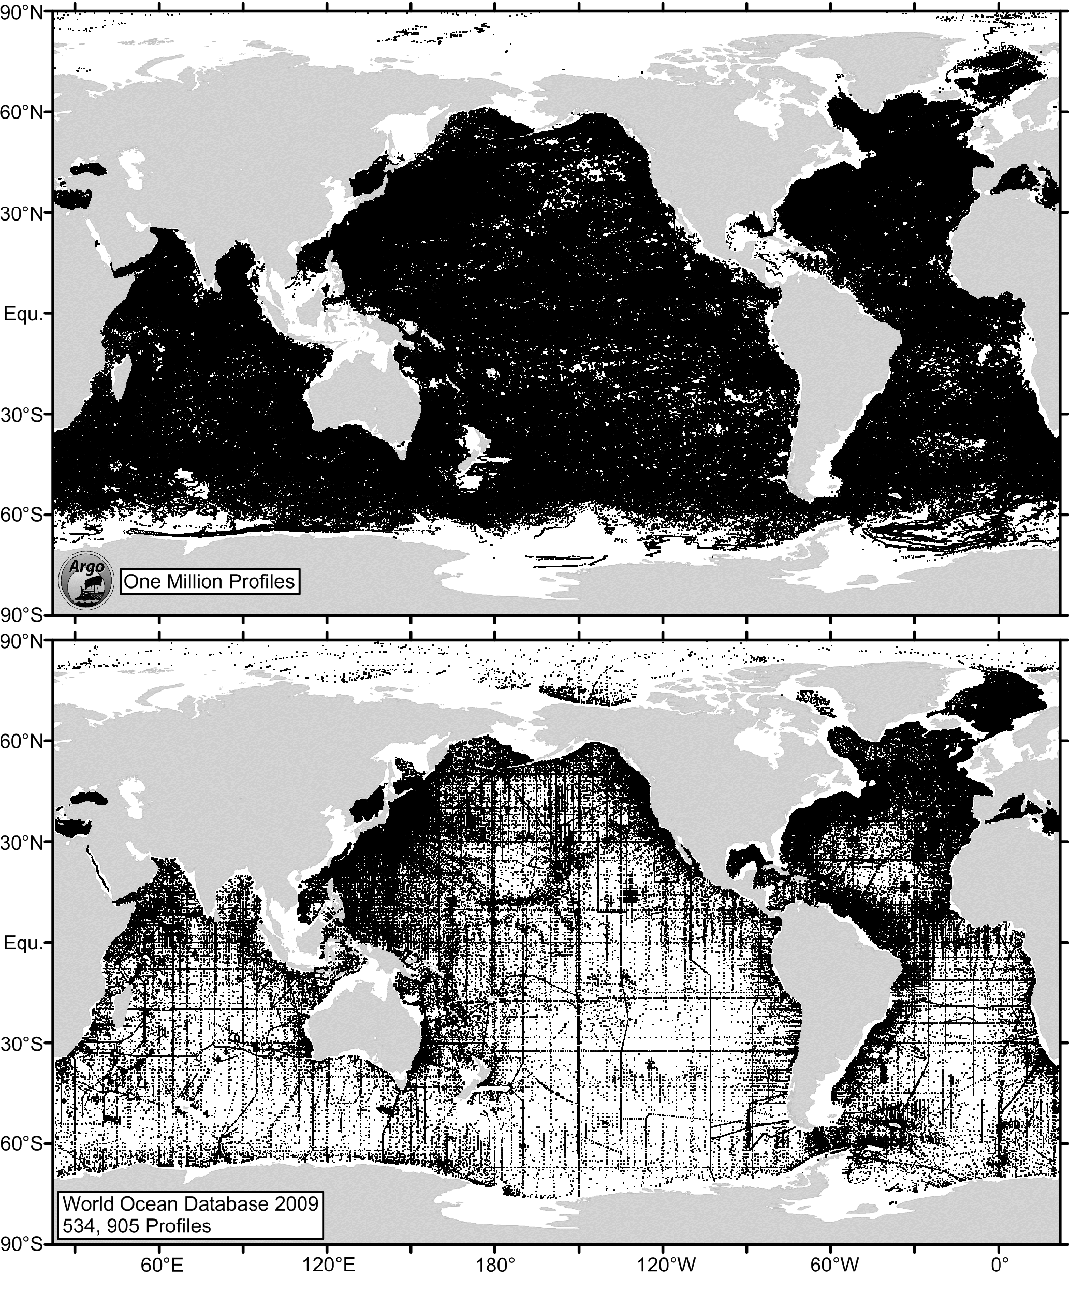
8
How do we know - the Argo system
Over 3000 robotic buoys
Measure conductivity (salinity) and temperature of the top 2000 m every 10 days
Paired with satellites (Jason)
This is now the best source of information on the world’s oceans, but it was not fully in place in 2007 (when AR4 was written)
Diagram contrasts Argo data with all previous ocean observations since 2001.

Slide 18
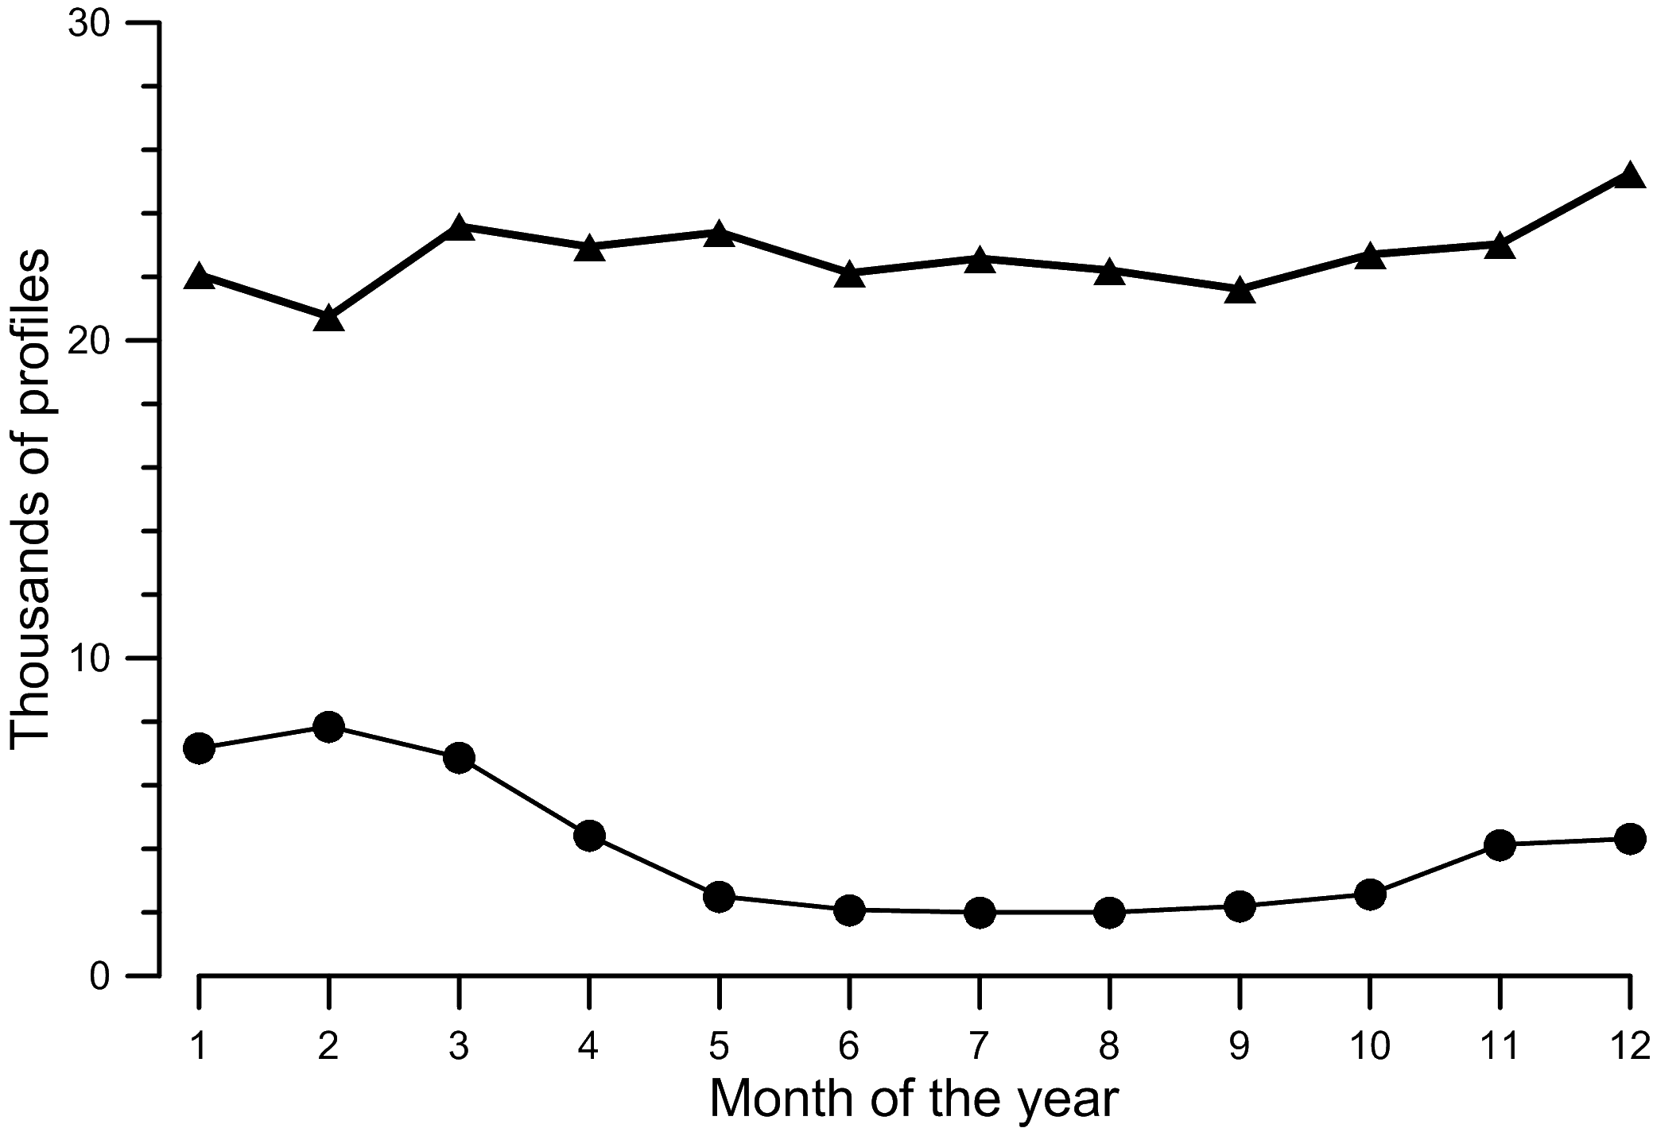
9
How do we know - the Argo system
Argo buoys operate in all seasons and all latitudes, eliminating the seasonal bias present in earlier observations
The diagram contrasts Argo observations per month with all previous observations south of 30°S latitude

Slide 19
Contribution of Working Group I to the Fifth Assessment Report of the Intergovernmental Panel on Climate ChangeClimate Change 2013: The Physical Science Basis(IPCC AR5 WGI)
Remarks by Graham Cogley
27 September 2013
J. Graham Cogley, Geography, Trent University, Peterborough, Canada
705-742-0317
gcogley@trentu.ca
www.trentu.ca/geography/glaciology
Notes:
*

Slide 20
IPCC AR5 and the cryosphere
Cryosphere = Glaciers, Ice sheets, Snow cover, Lake and river ice, Permafrost and Sea ice
Glaciers and ice sheets are losing mass
Some glaciers are shrinking faster than before
Glacier mass could decrease 15% to 85% by 2100
More difficult to project future of ice-sheet losses
Arctic sea ice continues to shrink and thin
The Arctic Ocean will likely be free of sea ice in September before mid-century
The cryosphere is doing just what we would expect
The glaciers are sending the same message as the thermometers at weather stations
Notes:
*

Slide 21
IPCC AR5 and sea level
Sea level rise has accelerated over the last 200 years
Influencing factors
Expansion of water as it warms (thermal expansion)
Melting of land-based ice sheets and glaciers
Storage of water in artificial reservoirs
Withdrawal of groundwater (groundwater mining)
New: We understand these factors better and can explain 20th century sea level rise
Oceans are absorbing excess heat
93% - Oceans
3% - Ice melt
3% - Ground
1% - Atmosphere
Notes:
*

Slide 22
IPCC AR5 and the water cycle
Wet regions are getting wetter, and dry regions are getting drier
This contrast is expected to grow over the 21st century
Salty parts of the ocean are getting saltier, and fresh parts are getting fresher
So oceanography and hydrology are sending the same message
Extreme events are getting worse
More extreme, more frequent or both
One study was able to answer the question “Was this flood caused by global warming?” The answer was “Yes”
Notes:
*

Slide 23
IPCC AR5 and the Cryosphere: What’s in it for Canada?
Canada’s ice is in bad shape
Canada’s Arctic glaciers are losing mass at record-breaking rates
South Ice Cap (Melville Island) broke its 2011 record in 2012
White Glacier (Axel Heiberg Island) broke its 2007 record in 2011
Glaciers in Western Canada are doing just as badly
Most Canadian permafrost appears to be warming
Shorter ice cover seasons on rivers and lakes
Northern hemisphere snow cover is shrinking
Notes:
*

Slide 24
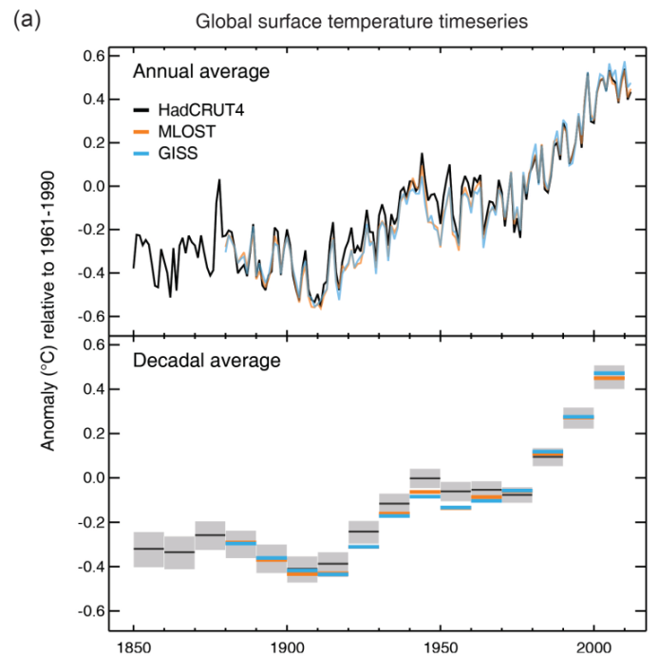
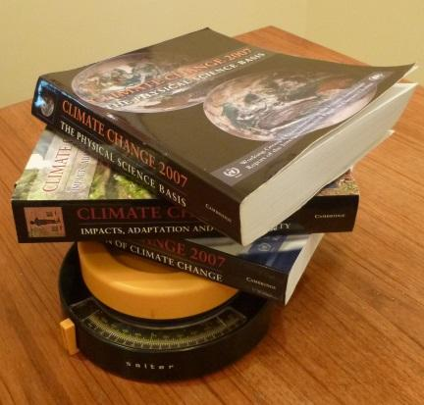
IPCC AR5: Some broad personal takes
The “global warming hiatus”
Fascinating, but it is climate variability, not climate change
The climate is changing — and we know why
IPCC reports are massive!
195 governments
AR4 weighed more than 15 pounds
Figure SPM.1
AR4
Notes:
*

Slide 25
Detection and Attribution of Climate Change: from Global to Regional
Dr. Xuebin Zhang, Research Scientist, Climate Research Division, Environment Canada
Lead Author, Chapter 10
Led the assessment on climate extremes for the Chapter

Slide 26
The totality of evidence of the human influence on climate has improved our confidence.
Upper ocean warming (very likely)
Global water cycle
  Changes in terrestrial precipitation pattern
  Increase in atmospheric humidity
  Changes in ocean surface salinity distribution
Reductions in snow and ice
  Reduced snow cover in Northern Hemisphere
  Loss of Arctic sea ice
  Reduced land glaciers
Global mean sea level rise
Climate extremes
  Changes in extreme temperatures
  Intensified extreme precipitation

Slide 27
Evidence of a human influence on climate:
AR4
AR5
Most of the observed increase in global average temperature since the mid-20th century is very likely due to the observed increase in anthropogenic greenhouse gases.
Discernible human influences now extend to other aspects of climate, including ocean warming, continental-average temperatures, temperature extremes and wind pattern
It is extremely likely that human influence has been the dominant cause of the observed warming since the mid-20th century.
Human influence has been detected in warming of the atmosphere and the ocean, in changes in the global water cycle, in reduction in snow and ice, in global mean sea level rise, and in changes in some climate extremes.

Slide 28
There is improved confidence of the human influence on extremes:
Phenomenon and direction of trend | AR4 | AR5
Warmer and/or fewer cold days and nights over most land areas | Likely | Very likely
Warmer and/or more frequent hot days and nights | Likely (nights only) | Very likely
Frequency and/or duration increase of heat waves | More likely than not | Likely
Increase in the intensity, frequency, or amount of heavy precipitation | More likely than not | Median confidence
Increase in intensity and/or duration of drought | More likely than not | Low confidence
Increases in intense tropical cyclone activity | More likely than not | Low confidence
Increased incidence and/or magnitude of extreme high sea level | More likely than not | Not assessed

Slide 29
Questions?
Please type your name and organization, and to whom you would like to address your question into the Chat box in the lower right of your screen. You will be un-muted to ask your question.
You can also ask your question by sending it to info@sciencemedia.ca.

Slide 30
Thank you!
Tyler Irving
SMCC Media Officer
613-301-1187
tyler.irving@sciencemedia.ca
Vincent Allaire
Agent pour les médias du CCSM
514-887-8279
vincent.allaire@sciencemedia.ca

