Slide 1


Slide 2

Webinar on the IPCC Fifth Assessment Report - Working Group II: Impacts, Adaptation and Vulnerability
Embargoed until 8 PM Eastern Time, Sunday, March 30, 2014

Slide 3
Expert panel
Paul Kovacs
Founder and Executive Director, Institute for Catastrophic Loss Reduction
Lead Author, Chapter 26 (North America)
Graham Cogley
Professor Emeritus of Geography, Trent University
Lead Author, Chapter 3 (Freshwater Resources)
John Stone
Adjunct Professor, Carleton University
Lead Author, Chapter 28 (Polar Regions)

Slide 4


IPCC Working Group II
March 2013
Summary of findings
North America Chapter
Paul Kovacs
Founder and Executive Director
Institute for Catastrophic Loss Reduction
Adjunct Research Professor, Economics
Western University

Slide 5
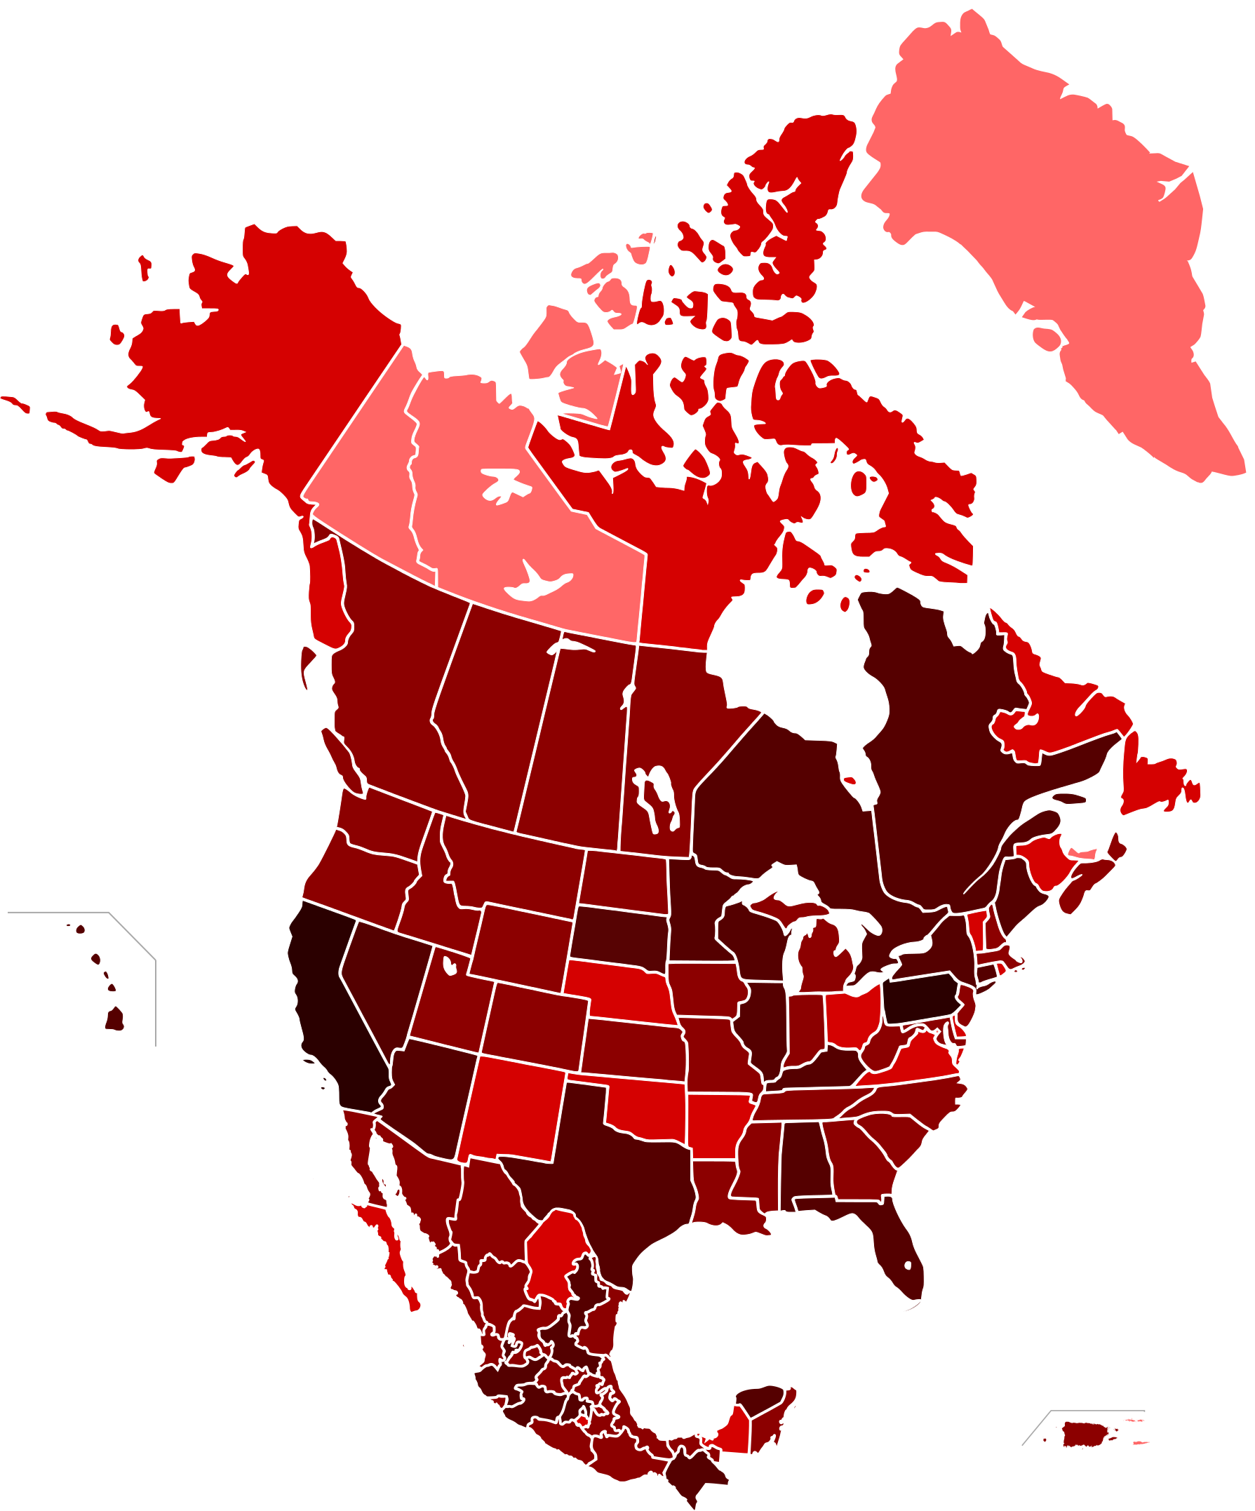
North America
The North America Chapter provides a synthesis of the climate impacts
and adaptation research for Canada, the United States and Mexico.
Impacts in the far North continue to be
assessed in the Polar regions chapter.
This is the first time IPCC has included
Mexico in North America.

Slide 6
Key findings
North America’s climate has changed and some societally-relevant changes have been attributed to anthropogenic causes (very high confidence). Recent climate changes and individual extreme events demonstrate both impacts of climate-related stresses and vulnerabilities of exposed systems (very high confidence).
Many climate stresses that carry risk – particularly related to severe heat, heavy precipitation and declining snowpack – will increase in frequency and/or severity in North America in the next decades (very high confidence).
North American ecosystems are under increasing stress from rising temperatures, CO₂ concentrations, and sea-levels, and are particularly vulnerable to climate extremes (very high confidence).

Slide 7
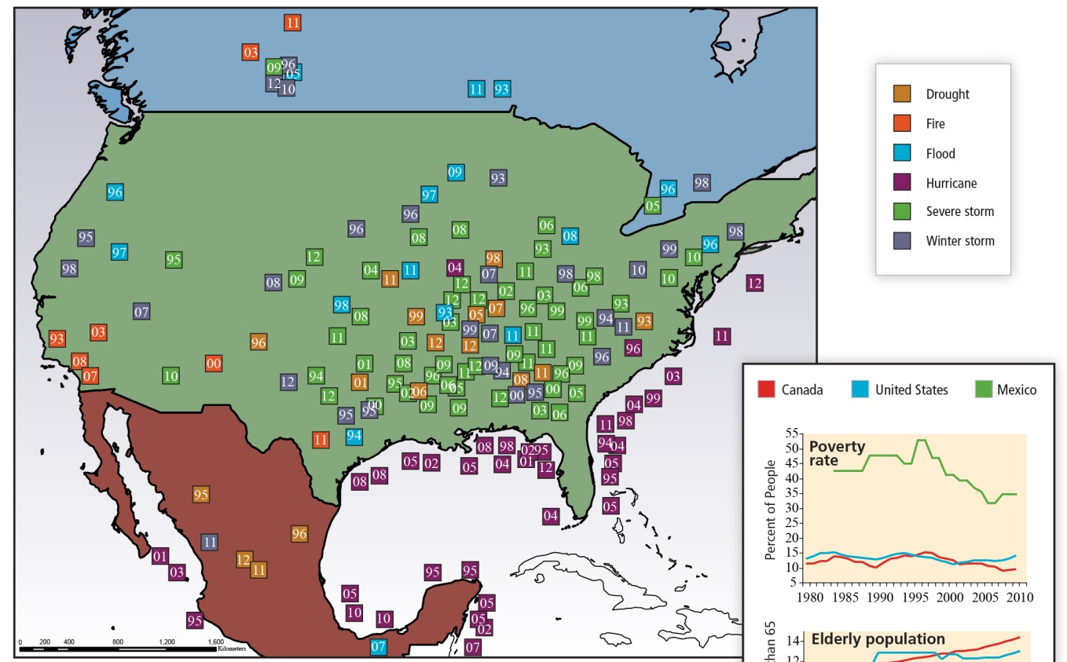
Extreme events illustrate vulnerability

Slide 8
Key findings
Water resources are already stressed in many parts of North America due to non-climate change anthropogenic forces, and are expected to become further stressed due to climate change (high confidence).
Effects of temperature and climate variability on yields of major crops have been observed (high confidence). Projected increases in temperature, reductions in precipitation in some regions, and increased frequency of extreme events would result in net productivity declines in major North American crops by the end of the 21st Century without adaptation, although the rate of decline varies by model and scenario, and some regions, particularly in the north, may benefit (very high confidence).
Human health impacts from extreme climate events have been observed, although climate change-related trends and attribution have not been confirmed to-date.

Slide 9
Key findings
Observed impacts on livelihoods, economic activities, infrastructure and access to services in North American urban and rural settlements have been attributed to sea level rise, changes in temperature and precipitation, and occurrences of such extreme events as heat waves, droughts and storms (high confidence).
Much of North American infrastructure is currently vulnerable to extreme weather events and, unless investments are made to strengthen them, would be more vulnerable to climate change (medium confidence).
Most sectors of the North American economy have been affected by and have responded to extreme weather, including hurricanes, flooding, and intense rainfall (high confidence).

Slide 10
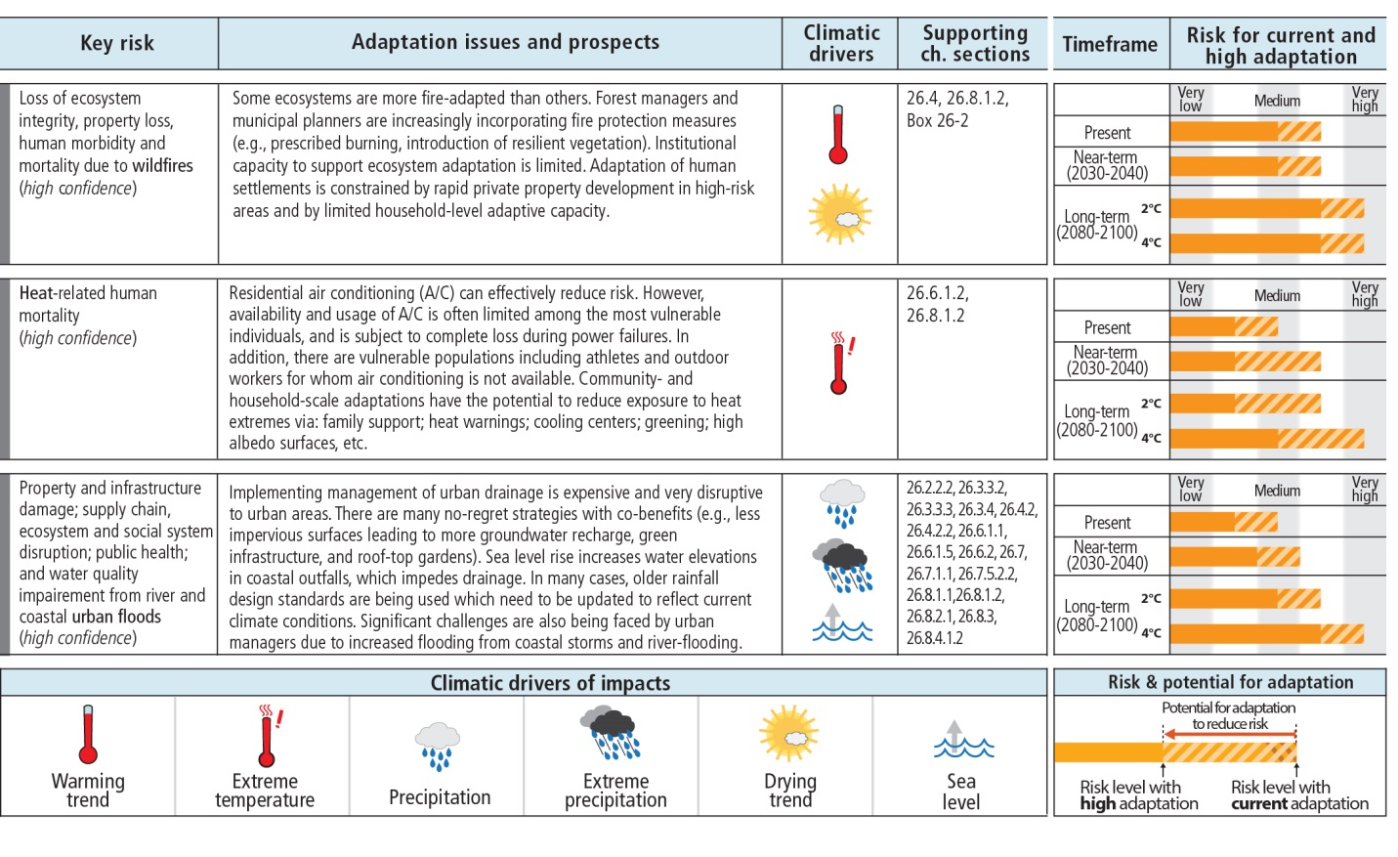
Key findings
Adaptation – including through technological innovation, institutional strengthening, economic diversification, and infrastructure design – can help to reduce risks in the current climate, and to manage future risks in the face of climate change (medium confidence).

Slide 11
Conclusions
Evidence is “unequivocal” that our climate has changed, and further significant change is inevitable.
We have the knowledge and capacity to reduce adverse impacts through adaptation.
Large, persistent losses from extreme events demonstrate our vulnerability to current risks.
Growing evidence of adaptation, largely in response to extreme events.

Slide 12
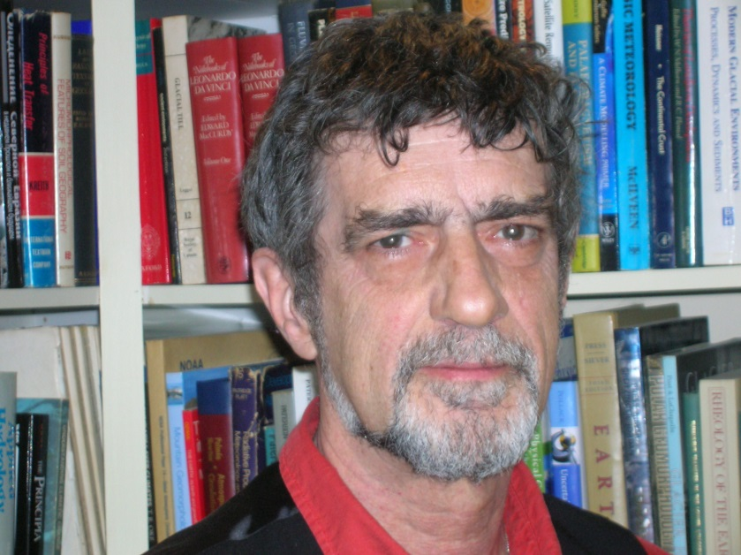
Climate Change 2014:
Impacts, Adaptation and Vulnerability
Contribution of Working Group II to the Fifth Assessment Report of the Intergovernmental Panel on Climate Change
(IPCC AR5 WGII)
Remarks by Graham Cogley
30 March 2014
J. Graham Cogley, Geography, Trent University, Peterborough, Canada
705-742-0317 gcogley@trentu.ca www.trentu.ca/geography/glaciology

Slide 13
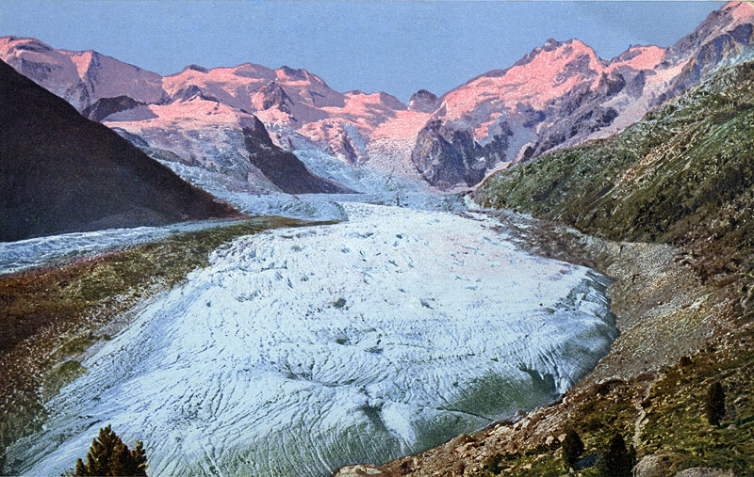
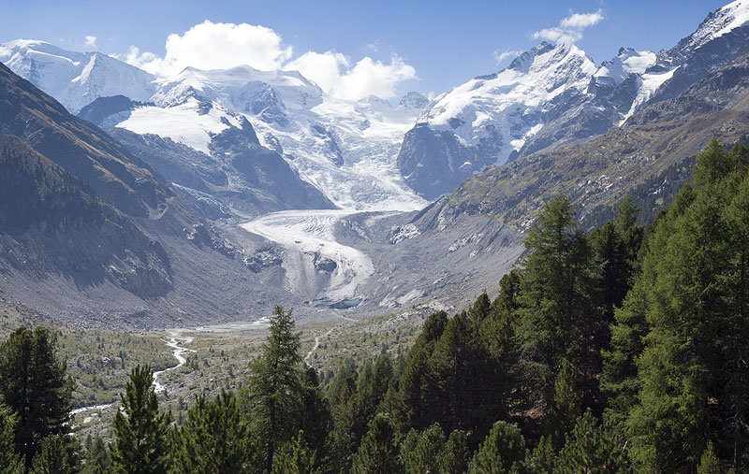
IPCC AR5 – Outline
The chain linking the greenhouse gases to their impacts is long and complex, but we are all but certain that the impacts will be widespread and consequential. I will discuss a few:
Glacier melting and its implications for society
Reduced access of people to freshwater
Increased flooding and connections to climate change
Morteratsch Glacier, Alps, 2012
Morteratsch Glacier, Alps, circa 1900
Credits: Jürg Alean

Slide 14
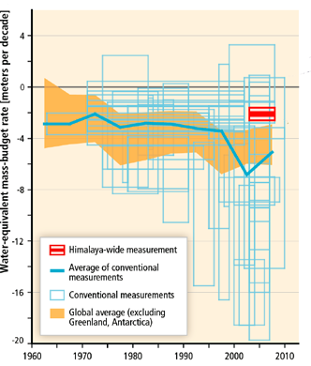
IPCC AR5 and Glacier Meltwater
Most glaciers are too big even for the present climate; future warming will only increase rates of loss and (eventually) disappearance
This means more water in coming decades (faster melting rates), but big trouble later (fewer glaciers)
Glaciers are essential contributors to water supply in several regions, such as Peru, the Alps and central Asia, but the Himalayas stand out
Published mass balances for Himalayan glaciers (blue boxes show uncertainty, negative numbers mean loss); global average in orange
Chapter 3 and Summary for Policymakers, IPCC AR5 Working Group II

Slide 15
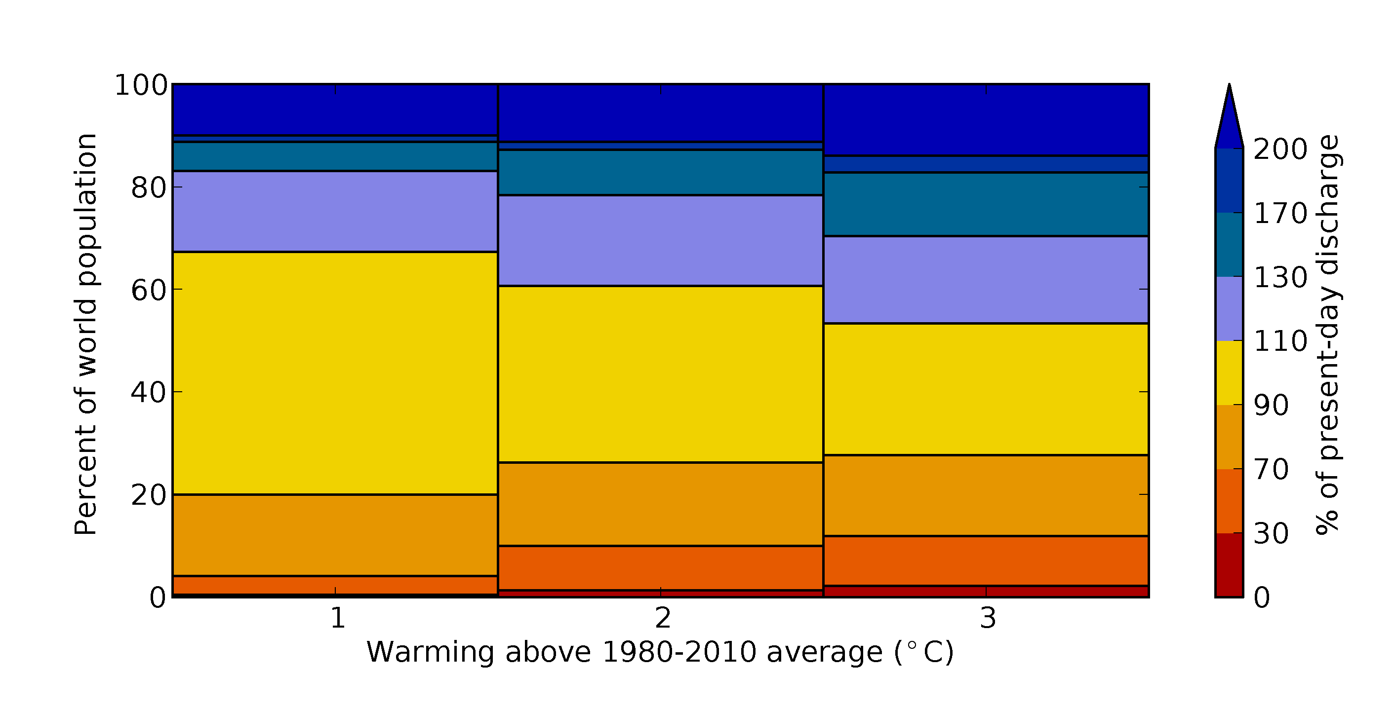
IPCC AR5 and Freshwater Resources
Human access to freshwater resources will continue to diminish: more people – farmers, city dwellers, skiers, etc. – will pay more for water, or will go short if they cannot pay
Schewe, J., and 24 others, 2014, Multimodel assessment of water scarcity under climate change, Proceedings of the National Academy of Science, 111(9), 3245-3250; Figure S6.

Slide 16
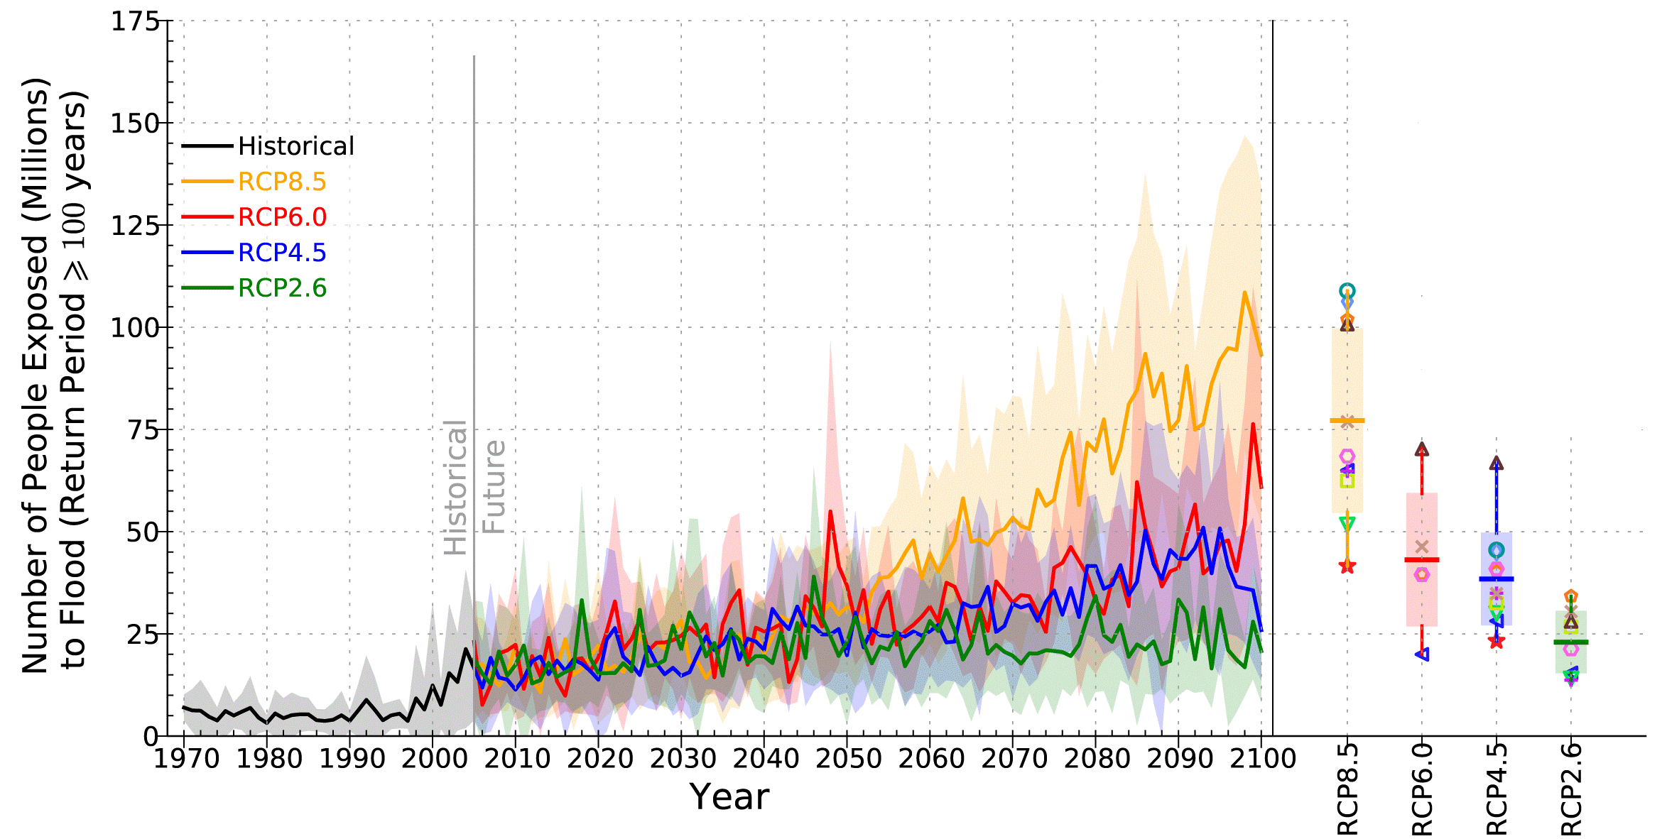
IPCC AR5 and Floods
A high-carbon future will expose more people to the risk of floods
Averages over 11 climate models
No population growth
At the moment we are on the orange path
Switching to the green path makes a difference!
Hirabayashi, Y., and 6 others, 2013, Global flood risk under climate change, Nature Climate Change, 3, 816-821.

Slide 17
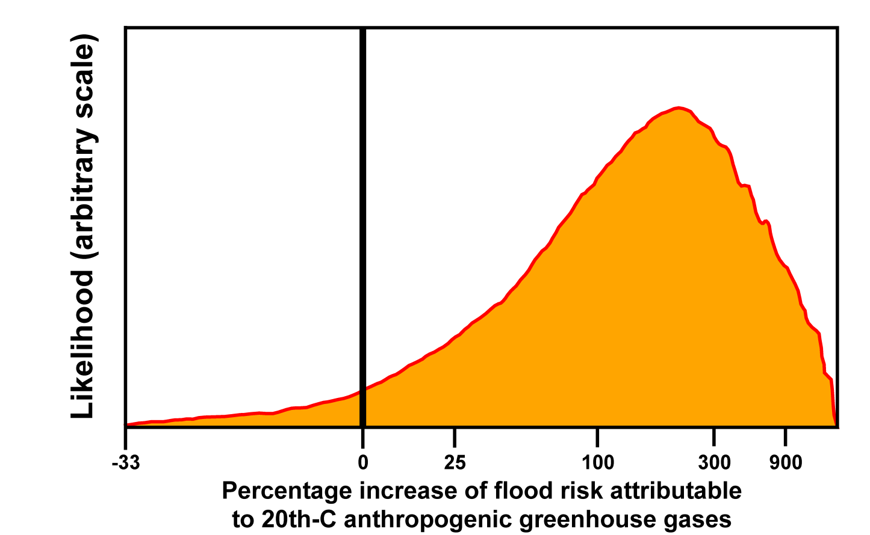
IPCC AR5 – A personal favourite
Questions like “Was this flood caused by global warming?” have been unanswerable up to now
However, using enormous computing power, a recent study showed that the UK floods of autumn 2000 were 2-3 times more likely to have occurred in a world with global warming than one without
Pall, P., and 7 others, 2011, Anthropogenic greenhouse gas contribution to flood risk in England and Wales in autumn 2000. Nature, 470, 382-385.

Slide 18
IPCC AR5 – Summary
Observed impacts are widespread and consequential
Risks are much greater in a world of continued high emissions, which increase the likelihood of severe impacts that may be complex, surprising, or irreversible
Impacts and risks will grow steadily worse over decades
Reducing emissions now can substantially reduce risks in the second half of the century
Not all the news is bad – opportunities for adaptation are there for the taking
Field, C., V. Barros and 69 others, 2014, Summary for Policymakers, IPCC AR5 Working Group II

Slide 19
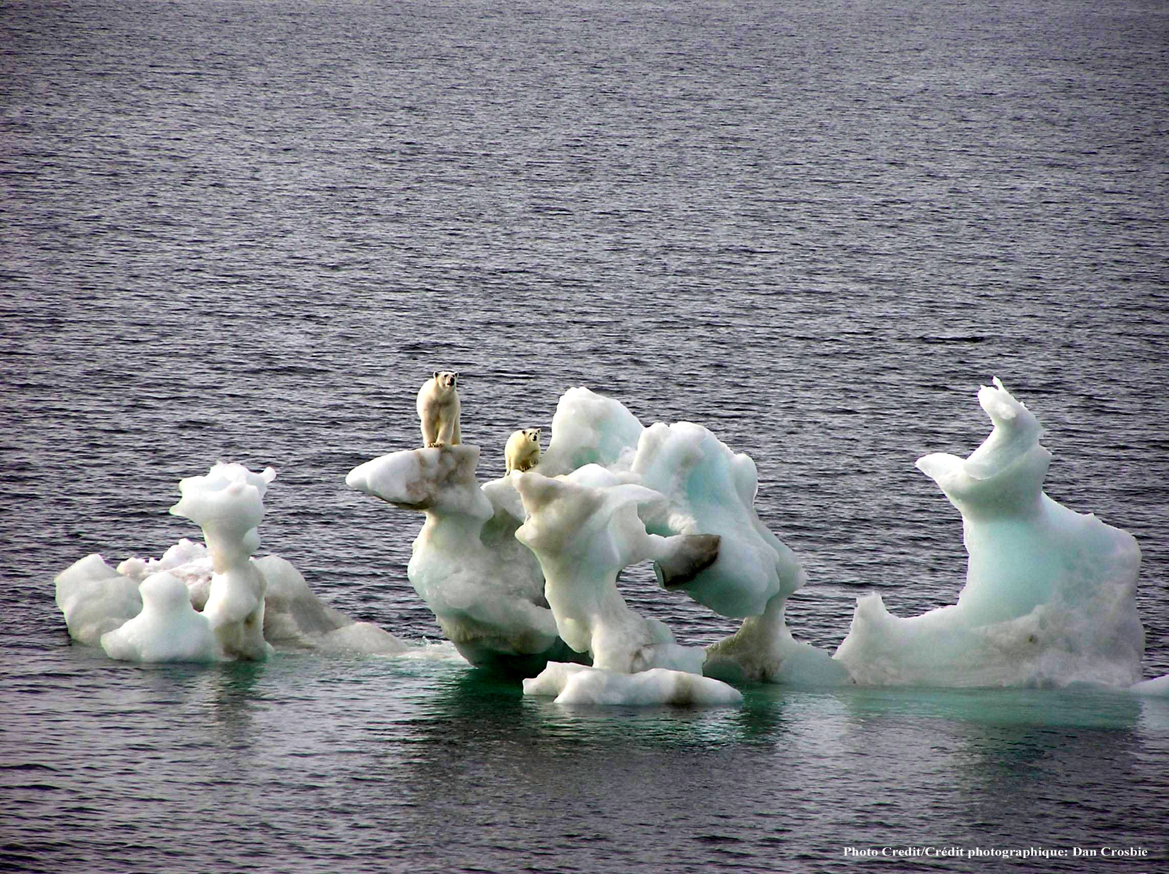
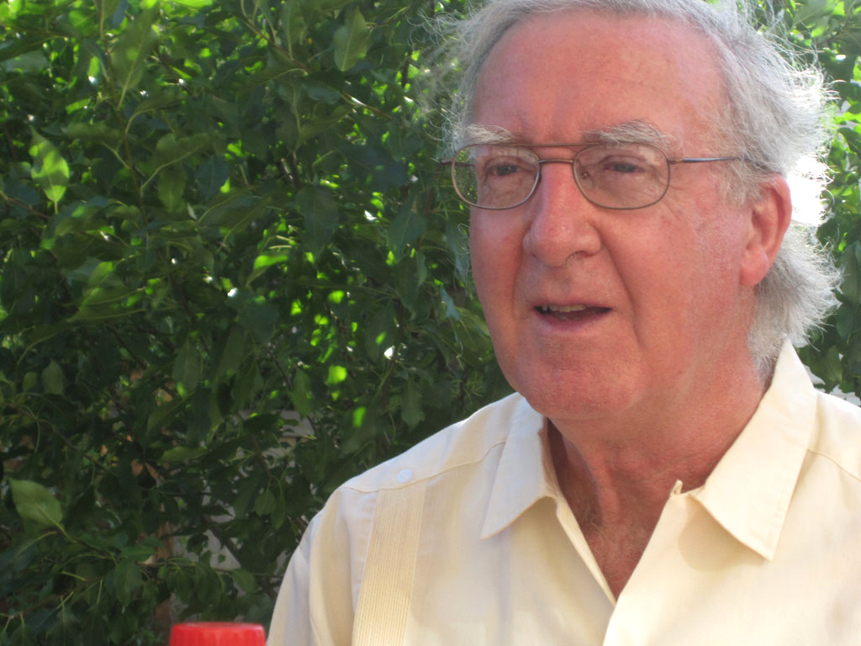
IPCC AR5 WGII
Polar Regions
John M R Stone
Carleton University
Notes:
I have chosen to focus on three of the findings of the Polar Regions chapter.
The first is to note the accelerated warming in the Arctic and the limitations this might place on our ability to adapt to climate change.
The other two points deal with impacts on peoples and communities in the Arctic and on marine ecosystems.
I will conclude by sharing with you some thoughts on the ability of the IPCC to deal with solutions, particularly adaptation options, having now defined the problem.

Slide 20
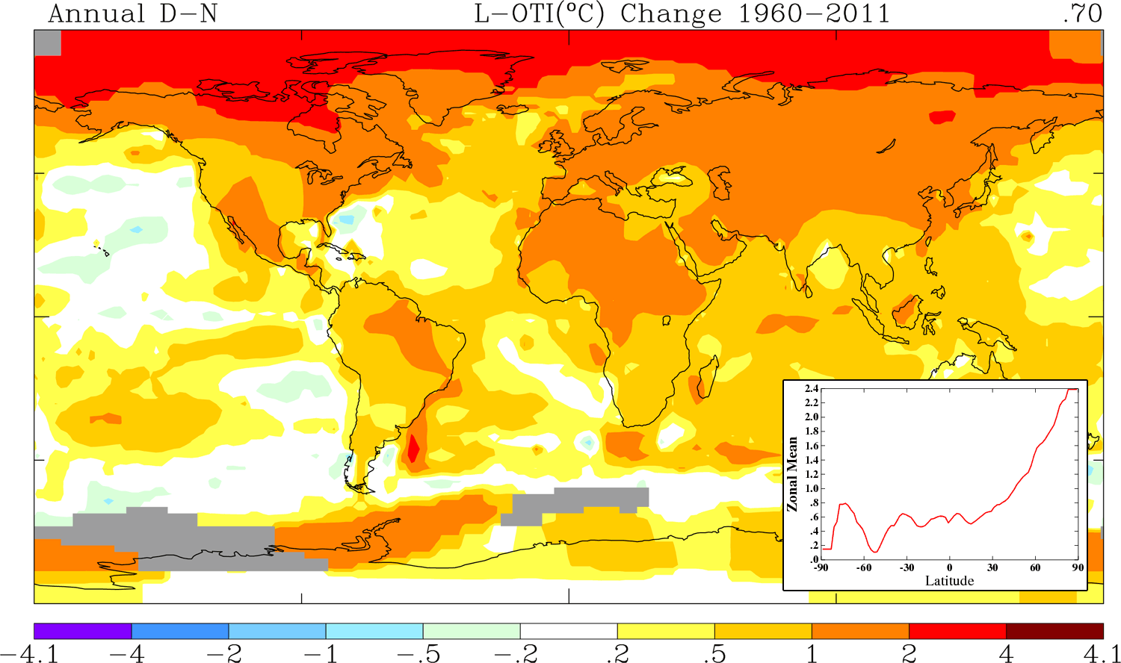
Accelerated Rate of
Climate Change in the Arctic
Notes:
Arctic surface air temperatures are increasing at 2-3 times the global average.
If our emissions continue to increase at the present rate by the end of the century global average temperatures could be as high as 4 ºC above pre-industrial levels with Arctic temperatures being as much as 11 ºC higher.
The Working Group II contribution to the IPCC 5th Assessment Report pays attention to the rate and not just the magnitude of climate change as was the focus in previous Assessment Reports.

Slide 21
Accelerated Rate of
Climate Change in the Arctic
Notes:
Arctic sea-ice cover and volume are declining faster then any of our models project. Observations in recent years are all lower than previous decadal means.
The Arctic could become free of sea-ice in summer within the next few decades rather than at the end of the century as was previously estimated.
The rapid rate at which climate is changing in the Polar Regions will impact natural and social systems and may exceed the rate at which some components can successfully adapt.

Slide 22
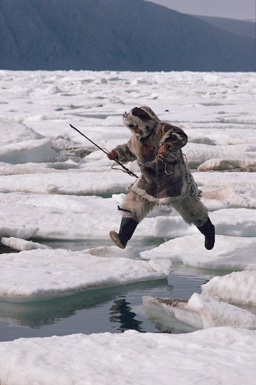
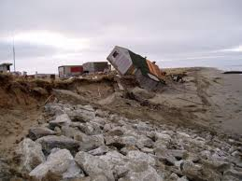
Arctic Peoples are Facing Unprecedented Challenges
Notes:
Climate change will exacerbate existing vulnerabilities.
Climate change’s physical, biological and socio-economic impacts in the Arctic have to be seen in the context of often interconnected factors. These include not only environmental changes caused by drivers other than climate change (for example Persistent Organic Pollutants) but also demography, culture and economic development.
Globalization and resource development are projected to increase significantly in the future with potential impacts on traditional lifestyles.
There is increased evidence that climate change will have large effects on Arctic communities, especially where relatively small and narrowly based economies leave a narrower range of adaptive choices.
Food security for many indigenous and rural residents in the Arctic, particularly those dependent on traditions country foods, is being impacted by climate change.
Accelerated rates of change in permafrost thaw, loss of coastal sea ice, sea level rise and increased weather extremes are forcing relocation of some indigenous communities in Alaska.
There will be increased risk to health and well-being of Arctic residents from changing physical environment; threats to livelihood and culture; lack of reliable and safe drinking water and damage to critical infrastructure, homes, and services.

Slide 23
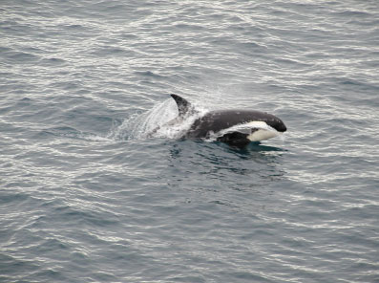
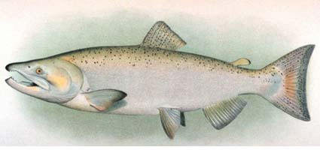
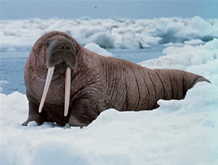
Marine Ecosystems will be Impacted
Notes:
Killer whales are now being see in Arctic waters and salmon are migrating to Arctic rivers.
Many marine mammals are highly specialized, long-lived and poorly adaptive. At particular risk are those that rely on sea-ice for feeding and rearing their young such as polar bears and some species of seals. Some species which spend only part of the year in the Arctic, such as killer whales, may be less at risk.
Projected changes in sea ice and ocean conditions (including acidification) are expected to have cumulative effects on marine ecosystem structure and function and hence economies on which they are dependent.
Shifts in the timing and magnitude of seasonal biomass production could disrupt the food webs, leading to decreased survival of dependent species. This impact would be exacerbated if shifts in timing occur rapidly.
Ocean acidification has the potential to inhibit embryonic development or shell formation of some zooplankton in the Polar Regions with potentially far-reaching consequences.
Climate change will increase the vulnerability of terrestrial ecosystems to invasions by non-indigenous species, the majority likely to arrive through direct human assistance.

Slide 24
Moving from Problem definition to Solutions
Climate change is now unambiguous and humans activities are the dominant cause.
IPCC has been successful at raising awareness of the threat of climate change.
Further impacts are now inevitable and adaptation a policy imperative.
Individuals, corporations and governments are now looking for solutions.
Can the IPCC fill this need?
Notes:
The IPCC was established to assess our knowledge of what is known and what remains unknown regarding the science of climate change.
Historically, WGII has focussed on climate change impacts.
The literature on adaptation was mainly in academic journals and dealt mostly with policies, plans and programs.
The AR5 contribution to the AR5 has a much richer treatment of adaptation.
However, much of the information on what works and what doesn’t work is in technical reports and manuals – in the heads of engineers. It is what is referred to as “grey literature”.
Much of this information is not easily accessible and not necessarily in English.
What is needed is more of a recipe book but the IPCC is currently not set up to provide this.
I tried to respond to this need in drafting the Polar Regions chapter but unevenness of material, inadequate objective assessments and space limitations made it very difficult.

Slide 25
Questions from Journalists
Paul Kovacs
Founder and Executive Director, Institute for Catastrophic Loss Reduction
Lead Author, Chapter 26 (North America)
Graham Cogley
Professor Emeritus of Geography, Trent University
Lead Author, Chapter 3 (Freshwater Resources)
John Stone
Adjunct Professor, Carleton University
Lead Author, Chapter 28 (Polar Regions)

Slide 26
Thank you!
Reminder – Under Embargo until 8 PM Eastern Time Sunday, March 30, 2014 (9 AM Yokohama Time, March 31, 2014)
Embargo will lift as IPCC’s press conference begins.
Livestream of IPCC press conference: http://www.ustream.tv/channel/ipcc38-en
www.sciencemediacentre.ca
Our Media Officers
Tyler Irving – 613-301-1187
Vincent Allaire – 514-887-8279

